Slide 1

Epigenetic Age in Age-Related Macular Degeneration
Kendrix Kek
9 October 2020
Notes:
Good morning everybody and happy Friday. Thanks for being here today. So today, I’ll be presenting on my attempt to use the epigenetic clocks to look at an age-associated disease in the eye known as age-related macular degeneration or AMD.

Slide 2
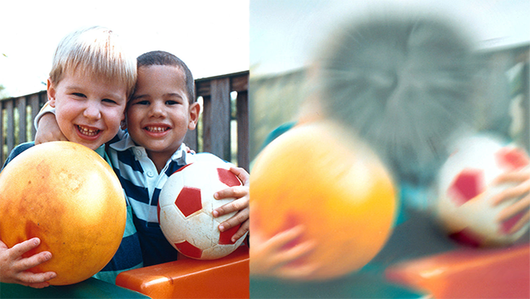
Brief background on AMD
Age-Related Macular Degeneration (AMD)¹:
Degenerative disorder of the central retina.
Most common sight impairment in those over 50 years old and leading cause of blindness in several populations².
Three forms: Early, intermediate, late AMD.
¹ Porter et al. Whole-genome methylation profiling of the retinal pigment epithelium of individuals with age-related macular degeneration reveals differential methylation of the SKI, GTF2H4 and TNXB genes. Clinical Epigenetics
² VanderBeek et al. Racial differences in Age-Related Macular Degeneration Rates in the United States: A Longitudinal Analysis of a Managed Care Network. American Journal of Ophthalmology.
Notes:
So I’ll start with a brief background of what AMD or Age-Related Macular Degeneration is. AMD is a common degenerative disorder that affects the central retina of those over 50 years old. It is the leading cause of blindness in several populations. The disease is characterised by the accumulation of fatty deposits called drusens in the central retina. The effect of that accumulation is that your vision becomes impaired as shown in this figure here. It primarily exists in three forms - early, intermediate and late AMD.

Slide 3
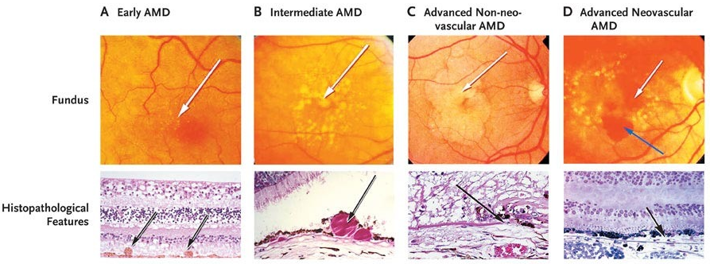
AMD is characterised by the size and accumulation of drusen in the retina.
Geographic atrophy
(dry AMD)
Choroidal neovascularization
(wet AMD)
Non-treatable
Treatable
^{Fig. 1} Jager et al. Age-Related Macular Degeneration. The New England Journal of Medicine.
Notes:
So the different forms of AMD are characterised by the size and accumulation of drusen in the retina. In the figure above, you can see the gradual increase in the size of drusen depending on the severity of the disease.
Early AMD is characterised by the presence of small or intermediate drusens (small = less than 63 microns; intermediate = 63 microns - 125 microns) in the retina. Note that small drusens are frequently observed in patients over 50 years old and can represent an epiphemenon of aging.
Intermediate AMD is characterised by intermediate or large drusens (63 microns - 125 microns) and...
Late AMD is characterised by the widespread accumulation of large drusens (more than 125 microns) in the retina.
Late AMD is subdivided into two subtypes: Geographic atrophy (or commonly known as dry AMD) and choroidal neovascularisation (or commonly known as wet AMD). The reason why they are called dry and wet AMD respectively is because dry AMD is caused by the accumulation of hardened drusens (which are dry fatty deposits), while wet AMD is caused by the leakage from blood vessels that grow under the retina. Because of the nature of choroidal neovascularisation, it is still possible to treat the disease, while there is currently no known treatment for geographic atrophy.

Slide 4
Both environmental and genetic risks factors contribute to the pathology of AMD.
Environmental and genetic risk factors
Age
Smoking
Gender
Cardiovascular disease
Diet
Ethnicity
Heritability of AMD*:
Overall: 46%
Intermediate: 67%
Late: 71%
*From 840 male twin pairs study (Seddon et al. 2005).
Seddon et al. (2005) The US Twin Study of Age-Related Macular Degeneration. Arch. Opthalmal.
^{Fig. 2} Warwick & Lotery (2018) Genetics and genetic testing for age-related macular degeneration. Eye.
Notes:
Much of the research has focused on the factors contributing to AMD pathology which include several environmental and genetic risks. In a 2005 study investigating 840 male twin from the US (440 monozygotic twins - share complete genetic makeup, and 400 dizygotic twins - share half of their genes), it was determined that the heritability of AMD is 46% and 71% for early and late AMD respectively. Since 46% - 71% of AMD variation may be explained by genetic factors, they have been extensively explored in the context of GWAS studies. Conversely, the heritability of AMD also highlights the relative importance of environmental risk factors such as smoking and diet in the early stages of the disease. This provides an avenue for disease exploration in an epigenetic context as it has been suggested that tissue-specific DNA methylation differences may be the key in understanding the interplay between genetic and environmental risk factors in AMD.
Seddon et al. (2005) The US Twin Study of Age-Related Macular Degeneration.
Twins from World War II Veteran Twin Registry.
Only if asked: On monozygotic and dizygotic twins - a trait influenced entirely by additive genetic factors should correlate perfectly in MZ twins and approximately 0.5 in DZ twins. A trait influenced entirely by shared environmental factors should correlate perfectly in both MZ and DZ twins. ACE (additive genetic, common environment and unique environment model) predicts DZ correlation ranging from 0.5 of MZ correlation (i.e. purely additive and unique environment) to being equal to MZ (i.e. purely common and unique environment).
Unique environmental factors accounting for 19% - 37% of the variation in AMD grade. No evidence for shared environmental factors (however, twins most likely had not been cohabiting for over 50 years, so it’s not surprising that shared environmental effects are not detected).

Slide 5
General overview of risks factors.
Environmental and genetic risk factors
Age
Smoking
Sex
Cardiovascular
disease
Diet
Ethnicity
Risk increases with age. (> 3-fold in patients over 75 years old as compared to patients between 65 – 74 years old).
Smoking is the most consistently identified modifiable risk factor.
Low antioxidants and high dietary fat intake also affect AMD incidence and progression.
Early AMD is common among black and Hispanic populations and late AMD is much more common in white population.
Potentially higher risk of neovascularized AMD in women of European ancestry, but no evidence of a substantial difference in overall AMD between men and women.
Sobrin & Seddon (2019) Nature and nurture – genes and environment – predict onset and progression of macular degeneration. Prog. Retin. Eye. Res.
Rudnicka et al. (2011) Age and gender variations in age-related macular degeneration prevalence in populations of European ancestry: a meta-analysis. Ophthal.
Notes:
Risk of AMD increases with age with 3-fold increases of AMD incidence amongst individuals over 75 years old as compared to individuals between 65 - 74 years old.
Smoking is the most consistent risk factor in AMD where the relative risk has been reported to decrease by 16% (2.4 -> 2.0) when the individual stops smoking.
There is also a global effect of diet in the incidence of AMD. Low dietary antioxidants and a high-fat diet can lead to increased risk of AMD by affecting the cardiovascular pathways.
Early AMD is commonly observed among Black and Hispanic populations, while late AMD is much more common in White populations.
Diagnoses of late AMD is slightly higher in women compared to men. However, it is important to note that this observed difference is in neovascularised AMD in women of European ancestry specifically. Comparing overall AMD in men and women does not show any substantial difference.
In this project, I’ll be investigating the role of age in AMD in the context of epigenetics. Specifically, I will characterise the incidence and progression of AMD using epigenetic clocks.
Only if asked:
Why smoking? Smoking adversely affects blood flow, decreases levels of high-density lipoprotein, increases platelet aggregability and fibrinogen, increases oxidative stress and lipid peroxidation, reduces plasma levels of antioxidants, and raises levels of inflammation and inflammatory cytokines.
Why high-fat diet and antioxidants? The deposit of oxidised compounds in healthy tissue could result in cell death because they are indigestible by cellular enzymes in the eye. This could lead to impaired function of the RPE and eventually to degeneration involving the macula. High-fat diet likely affects AMD through the HDL cholesterol and systemic inflammatory pathways (See above).
Why ethnic differences in AMD? Inherited genetic factors determined by genetic ancestry play a substantial part in age-related macular degeneration. Also, most studies are localised to specific geographical locations, so it is suggested that there could be some sampling bias.
Why more late AMD in women? The higher prevalence of late AMD in women is due to potential cerebrovascular and/or hormonal/menopausal mechanisms: Neovascularised AMD seems to share some similarities with stroke. Women experience their first strokes later in life and have higher incidence of stroke at an age when neovascularised AMD commonly occurs (an age at which male cardiovascular-related mortality may have already occured = in short, because women live longer than men). [But important to stress that no evidence of any substantiated difference between men and women in overall AMD] (See below).
NOTE: A meta-analysis of 25 published studies (over 57000 subjects) identified no evidence of interaction between age and gender (i.e. prevalence of AMD increases exponentially by age, which did not differ by gender).

Slide 6
Question:
Can increased risk of AMD with age be partially characterized with epigenetic clocks?
Notes:
This leads to my main question for this project, which is: Can the increased risk of AMD with age be partially characterised with epigenetic clocks? I expect that samples from AMD patients will have higher age acceleration as compared to controls.

Slide 7
E-MTAB-7138 Pre-Processing
Notes:
To help me answer my question, I’ll briefly walk you through the publicly available dataset that I’m using and the pre-processing steps that I have undertaken to clean it up for analysis.

Slide 8
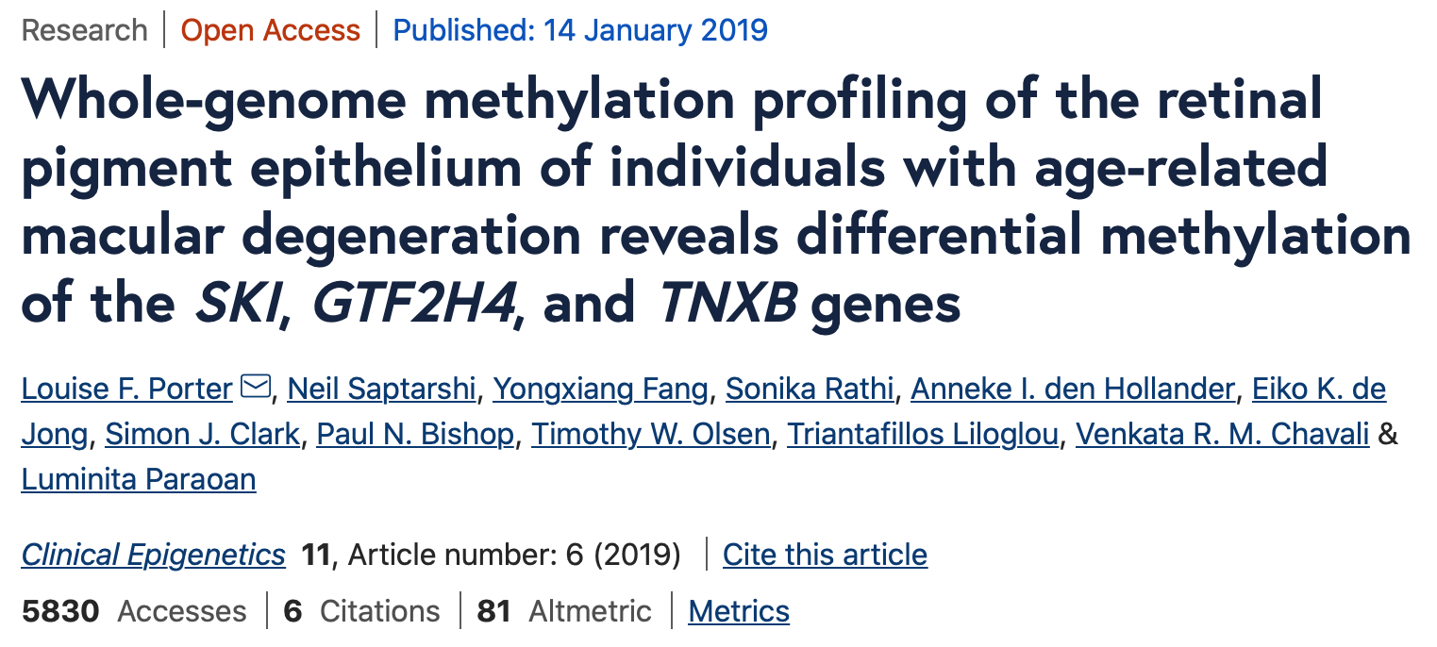
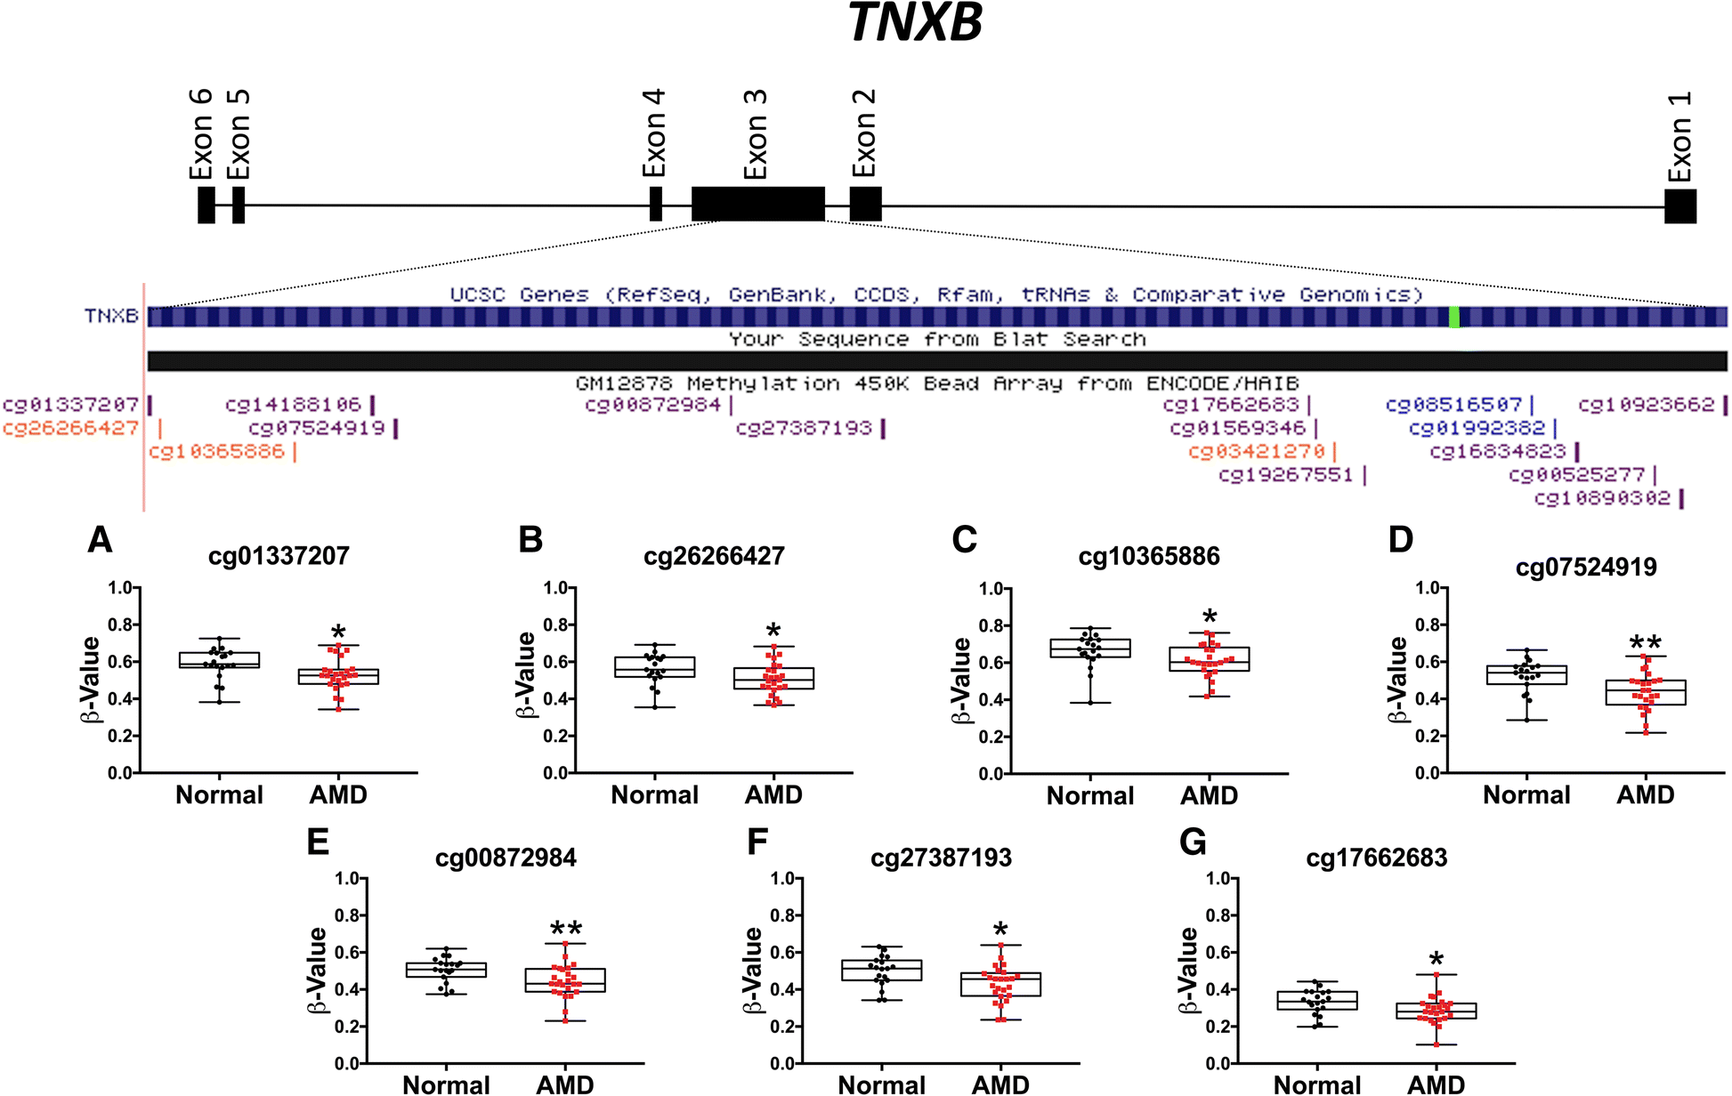
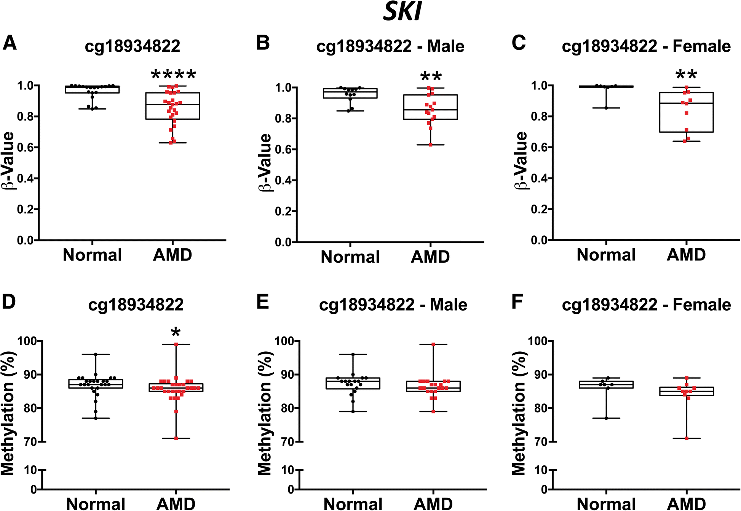
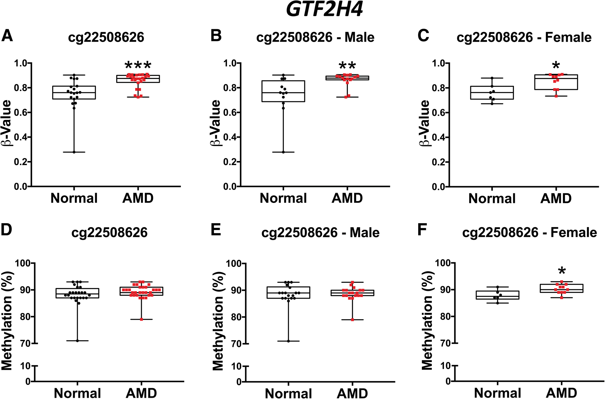
Identified 3 differentially methylated sites associated with AMD. No sex-specific sites.
TNXB
SKI
GTF2H4
Notes:
The dataset from this project was taken from a published paper that found 3 candidate sites that are associated with AMD. The basis of the paper is to look for epigenetic targets for therapeutic interventions in the disease in the attempt to influence differential gene expression in early/intermediate AMD. The authors set out to answer two main questions in their study: (1) Are there epigenetic sites that are associated with SKI, GTF2H4 and TNXB, which are genes that regulate the disease pathways in AMD? (2) Are there sex-specific differential methylated sites based on past studies that women have a higher risk of developing AMD than men?
They managed to find the differentially methylated sites that reach genome-wide significance that are responsible as regulators of these genes, however, they did not manage to identify sex-dependent sites that are associated with AMD.

Slide 9
Data Import and Clean-up
44 samples, 485 577 probes
Metadata and IDATs are imported from ArrayExpress and explored.
Accession Number: E–MTAB–7183
Metadata contains:
44 samples
Age: 50 years old – 89 years old
Sex: Male (N: 27) and Female (N: 17)
Disease State: AMD (N: 25) or Normal (N: 19)
Tissue: Retinal pigment epithelium (N: 44)
Organism: Homo sapiens (N: 44)
Sample Quality Control
44 samples, 485 577 probes
Normalisation: Noob
44 samples, 485 577 probes
Normalisation: Funnorm
44 samples, 485 577 probes
Epigenetic Clocks
44 samples, 485 577 probes
Probe Filtering
44 samples, 425 456 probes
SVA
44 samples, 425 456 probes
Cell Type Deconvolution
44 samples, 425 456 probes
EWAS
44 samples, 425 456 probes
Notes:
The dataset I will be using contains 44 samples with ages ranging from 50 to 89 years old. The sex and disease state of the samples are quite evenly split. All the samples from the dataset comes from the retinal pigment epithelium with no health history or cause of death provided, and the donors are most likely based in the UK as all tissues were from the Manchester Eye Bank in the UK.
To prepare this data, I used our Kobor lab pipeline, importing the raw idats and metadata from ArrayExpress (which is a European-based data repository for microarray and sequencing datasets) into R and performed some preliminary exploration of the available metadata.

Slide 10
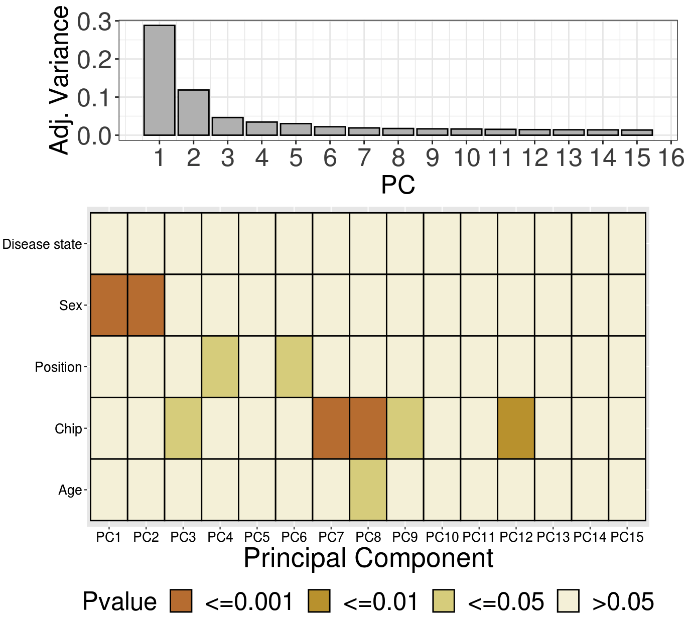
Sex is the main source of variation in this data.
Data Import and Clean-up
44 samples, 485 577 probes
Sample Quality Control
44 samples, 485 577 probes
Normalisation: Noob
44 samples, 485 577 probes
Normalisation: Funnorm
44 samples, 485 577 probes
Epigenetic Clocks
44 samples, 485 577 probes
Probe Filtering
44 samples, 425 456 probes
SVA
44 samples, 425 456 probes
Cell Type Deconvolution
44 samples, 425 456 probes
EWAS
44 samples, 425 456 probes
Notes:
Preliminary PCA on the raw data shows that sex is the major source of variation in this dataset. It is interesting to see that age does not show up in the top PCs and disease state does not show up at all, so further exploration is needed to understand why that is.
The raw data PC explanation: Sex appears in the top PC because it may be confounded by cell type - as cell type usually comes up first. Batch is confounded with other variables, such as disease state confounded with batch, which makes the data noisy - and also disease is not expected to be a large source of DNAm difference.

Slide 11
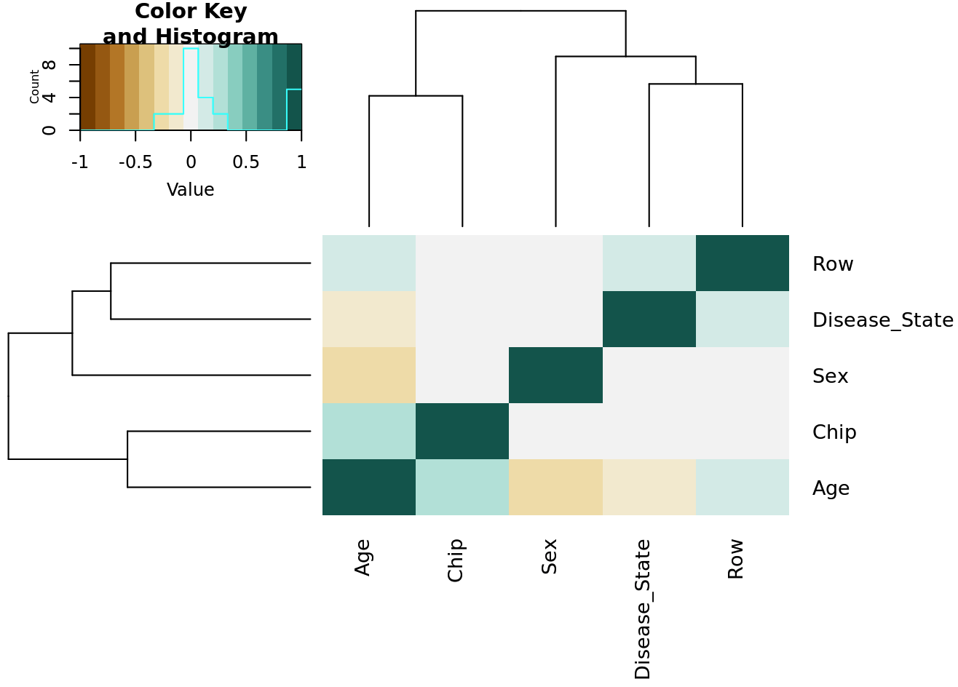
Potential confounding between different variables in the metadata.
Data Import and Clean-up
44 samples, 485 577 probes
Sample Quality Control
44 samples, 485 577 probes
Normalisation: Noob
44 samples, 485 577 probes
Normalisation: Funnorm
44 samples, 485 577 probes
Epigenetic Clocks
44 samples, 485 577 probes
Probe Filtering
44 samples, 425 456 probes
SVA
44 samples, 425 456 probes
Cell Type Deconvolution
44 samples, 425 456 probes
EWAS
44 samples, 425 456 probes
Fig. 4: Correlation between the variables in the metadata.
Notes:
Because it is a little concerning that age is not one of the main sources of variation as we typically see, I looked at a correlation matrix between all the variables that are available in the metadata. From this plot, you can see that age is correlated with chip and disease state is correlated with row, and and sex and disease state are both correlated with age. These are limitations of the data that I have to keep in mind as I proceed with my analysis moving forward.

Slide 12
Data Import and Clean-up
44 samples, 485 577 probes
Criteria:
Detection p-value (< 0.01)
Bead count (> 3)
Median intensities check
Control metrics
Contamination check
Sample relations
Outlier detection
Sex check
0 sample removed, 44 samples remaining.
Sample Quality Control
44 samples, 485 577 probes
Normalisation: Noob
44 samples, 485 577 probes
Normalisation: Funnorm
44 samples, 485 577 probes
Epigenetic Clocks
44 samples, 485 577 probes
Probe Filtering
44 samples, 425 456 probes
SVA
44 samples, 425 456 probes
Cell Type Deconvolution
44 samples, 425 456 probes
EWAS
44 samples, 425 456 probes
Notes:
Next I will quickly walk you through the checks that I have performed to filter out any bad samples. I performed an extensive check on these biological and technical metrics to ensure that the samples are up to par. Fortunately, all samples passed the checks so I did not need to discard any sample from this dataset, as the sample size is already quite low.

Slide 13
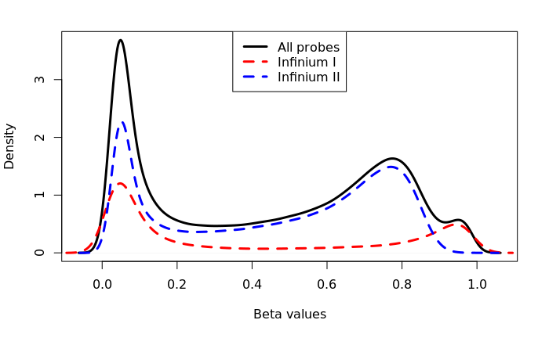
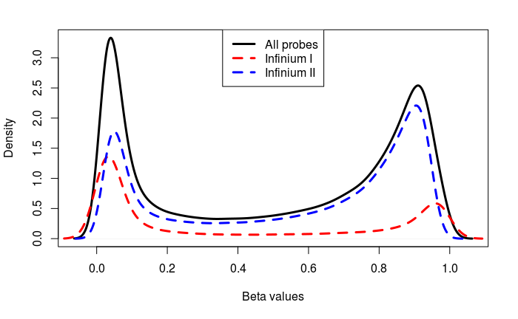
Data Import and Clean-up
44 samples, 485 577 probes
Sample Quality Control
44 samples, 485 577 probes
Raw distribution
Normalisation: Noob
44 samples, 485 577 probes
Normalisation: Funnorm
44 samples, 485 577 probes
Epigenetic Clocks
44 samples, 485 577 probes
Probe Filtering
44 samples, 425 456 probes
SVA
44 samples, 425 456 probes
Noob-normalised distribution
Cell Type Deconvolution
44 samples, 425 456 probes
EWAS
44 samples, 425 456 probes
Notes:
As Horvath recommends using pre-normalised data, I only performed noob-normalisation to correct for background fluorescence and dye bias, as was suggested by David. The resulting distributions overall and between probe types are more comparable to one another after this step.
Only if asked: Noob normalisation uses out-of-band probes on the array to estimate non-specific signals from the out-of-band intensities (which are wavelengths that are in the opposite colour channel to their design). These signals are then normalised in average intensity in the red and green colour channels.
Potential argument for a different choice of normalisation - While it is true that the choice of normalisation can introduce some variation by influencing the mean values of DNAm age, the predicted ages demonstrated in Lisa’s paper are still within the error margin of the clocks.

Slide 14
Epigenetic Clocks

Slide 15
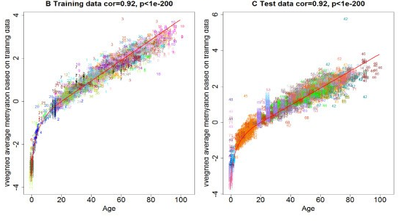
What is an epigenetic clock?
Uses the methylation profile of age-associated CpGs to approximate biological ages.
Methylation state of these sites change gradually over time.
Insight into determining the aging rate of certain tissues – indicative of various health outcomes.
Pan-tissue vs tissue-specific clocks vs clocks for phenotypic age.
Important terms:
Age acceleration = Predicted biological age (DNAmAge) – chronological age
Age acceleration residual = Residual of DNAmAge ~ Age
Horvath (2014) DNA methylation age of human tissues and cell types. Genome Biology
Notes:
For those of you who are not familiar with epigenetic clocks, allow me to quickly provide you with the brief concept of what an epigenetic clock is. Epigenetic clocks are biomarkers of aging that use the methylation profile of age-associated CpG sites to approximate biological ages of tissues. They leverage the linearity of the methylation states of these sites that change gradually as we age. They are often used as powerful tools to provide the researcher an insight into determining the aging rate of certain tissues or individuals to indicate various health outcomes. Early epigenetic clocks are built as tools to approximate biological aging, but since then there has been an increase in the development of clocks that leverage other phenotypic profiles to approximate phenotypic aging. In this presentation, I will be using two important terms which are age acceleration, which is the difference between the predicted biological age and chronological age; and age acceleration residual which is the residual resulting from regressing predicted biological age with chronological age, although in the field, age acceleration residual is more broadly used to represent age acceleration as some residual terms take into account the underlying cell-type differences of the tissue predicted and thus are more biologically meaningful.
After normalisation, I uploaded my dataset onto Horvath’s online calculator to produce readings for various epigenetic clocks.
Only if asked: What are the functions of the age-associated CpG sites? According to Horvath, the sites that are associated with the clock show significant enrichment for cell death/survival, cellular growth/proliferation, organismal/tissue development.
Horvath proposes the idea that the DNAm age measures the cumulative work done by a kind of epigenetic maintenance system, which helps to maintain epigenetic stability. If this EMS model of DNAm age is correct, then DNAm age should be accelerated by many perturbations that affect epigenetic stability.
Hannum’s extrinsic age acceleration has been described as a biomarker of immune system aging, and has been found to be associated with a wide range of traits, indicating a sensitivity to variations in environment and lifestyle.
Horvath’s extrinsic age acceleration is considered to be a fundamental, intrinsic cellular aging process, largely unrelated to lifestyle factors, although associations with a range of metabolic syndrome characteristics suggest a role in tracking metabolic aging processes. Meanwhile the greater number of significant variants, genomic loci, and genes associated with Horvath-EAA are consistent with the hypothesis that this measure of “cell-intrinsic” aging is less related to lifestyle and more under genetic control, and thus more likely to remain relatively stable.

Slide 16
Hypothesis:
Predicted biological age using the epigenetic clocks is higher for AMD samples as compared to normal samples.
Age acceleration of AMD samples is higher as compared to normal samples.
Notes:
I expect the predicted biological ages of AMD samples to be higher than normal samples using the epigenetic clocks. I also expect the age acceleration of AMD samples to be higher as compared to normal samples. As epigenetic clocks are biomarkers for biological aging, accelerated aging may represent higher health burden due to age-associated-diseases like AMD.

Slide 17
Characteristics of various epigenetic clocks.
Epigenetic Clock | Purpose | DNAmAge CpGs | Age Range | N (Training) | Tissues (Training)
DNAmHorvath (Horvath 2013) | Pan-tissue biological age predictor | 353 | 0 – 100 | 7,844 | 24 different tissues incl. whole blood, PBMC, brain tissues
DNAmSkin&Blood (Horvath et al. 2018) | Skin & blood-based biological age | 391 | -0.28 – 94 | 896 | Whole blood, cord blood, buccal, epithelium, fibroblasts, skin
DNAmCortical (Shireby et al. 2020) | Brain-based biological age | 347 | 1 – 108 | 1,047 | Cortex
DNAmZhang (Zhang et al. 2019) | Blood-based biological age | 514 | 2 – 104 | 13,566 | Whole blood, saliva
DNAmHannum (Hannum et al. 2013) | Blood-based biological age | 71 | 19 – 101 | 656 | Whole blood
DNAmWeidner (Weidner et al. 2014) | Blood-based biological age | 3 | 0 – 78 | 575 | Whole blood, cord blood
DNAmPhenoAge (Levine et al. 2018) | Biomarker for lifespan | 513* | 9.1 – 106.1 | 456 | Whole blood
*CpGs that underlie surrogate biomarkers for phenotypic health.
Notes:
Before I present you with the epigenetic clock results, I’ll like to share some characteristics of the clocks with you. All the clocks differ by the age-associated CpG sites that they are built on. They also have vastly different sample sizes and tissue types for their training datasets. The most well-known epigenetic clock is Horvath’s clock, which is said to be able to predict the biological age of any tissue as it was built using 24 different sources. There are some tissue-specific clocks that are said to be more accurate in their prediction within tissue types that they are trained on such as Zhang’s clock and the Cortical clock. The difference between the two types of clock highlights a delicate balance that was considered when building a clock, either to build a widely applicable clock such as Horvath’s clock that may be hampered by its high error rate (in Horvath’s case, up to 3 years), or to build a clock based on a specific tissue set that will be more accurate but lacks in its applicability across different tissues, even though some has demonstrated their utilities to predict a small range of different tissues. There is also an increasing development of so-called second-generation clocks that are trained on not only chronological age, but also age-related and disease phenotypes such as mortality. For example, clocks such as PhenoAge and GrimAge incorporate various age-related biochemical measures, which allows the clock to capture age-associated phenotypes.
I started with Horvath’s clock because the source tissue of this data is retinal pigment epithelium, and Horvath’s clock is a pan-tissue clock, so theoretically it should be able to predict age in these samples. Since the tissue that I’m using is so unique and not included in any of the training data for any currently available clocks, I decided to try my tissue with most of them to see how well they perform with my tissue. Overall, I explored 7 epigenetic clocks in total.
Why did I choose Horvath’s clock: Pan-tissue.
Why did I chose Skin&Blood clock: Said to be able to accurately predict neurons, glia, brain.
Why did I choose Cortical clock: Accurately predict different brain cells.
Only if asked:
Why was Skin&Blood clock built: To overcome the sub-optimal prediction of Horvath’s clock for fibroblast tissues and to address a need for a fibroblast predictor that is widely used in ex vivo intervention studies.
Why was Cortical clock built: Existing clocks work sub-optimally in the human cortex, systematically underestimating age in elderly individuals.
Why was Zhang’s clock built: Argues that predictors based on small sample sizes are prone to confounding by cellular compositions (said that Horvath & Hannum’s clocks were enriched in CpGs that show DNAm heterogeneity across cell types), so wanted to build a predictor that best capture underlying age-associated sites can robustly estimate epigenetic age.
Why was Hannum’s clock built: Hannum predates Horvath’s clock, initially to characterise aging in blood.
Why was Weidner’s clock built: Hannum predates Horvath’s clock, wanted to see if they can find a cost effective method of characterising biological age using a little CpG sites as possible - using bisulfite sequencing. Horvath thinks that their age prediction is rubbish - high error rate (up to 13 years).
Why was PhenoAge clock built: Wanted to build a clock that can predict various aging outcomes - all-cause mortality, cancers, healthspan, physical function and Alzheimer’s.

Slide 18
CpG sites overlap
Notes:
Overlap between the age-associated CpGs for all the clocks that I used.

Slide 19
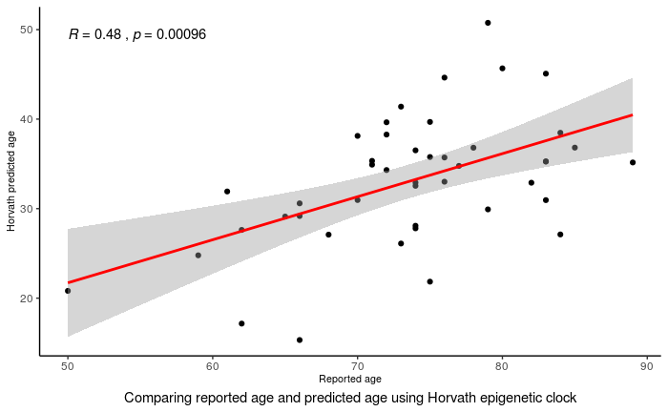
Among all epigenetic clocks tested, Horvath’s pan-tissue clock seems to predict the biological age of the samples the best.
Epigenetic Clock | DNAmAge CpGs | Predicted Age Range | Actual Age Range
DNAmHorvath (Horvath 2013) | 353 | 15.32 – 50.76 | 50 – 89
DNAmZhang (Zhang et al. 2019) | 514 | 17.97 – 48.40 | 50 – 89
DNAmHannum (Hannum et al. 2013) | 71 | 13.09 – 44.86 | 50 – 89
DNAmWeidner (Weidner et al. 2014) | 3 | -0.74 – 49.20 | 50 – 89
DNAmSkin&Blood (Horvath et al. 2018) | 391 | 0.85 – 14.04 | 50 – 89
DNAmPhenoAge (Levine et al. 2018) | 513 | -51.75 – 8.87 | 50 – 89
DNAmCortical (Shireby et al. 2020) | 347 | -18.56 – (-12.61) | 50 – 89
Notes:
After I applied the clocks to my dataset, I saw a systematic underestimation of the predicted biological ages of my samples across all clocks.
Among all epigenetic clocks tested, Horvath’s clock was able to produce predicted biological ages that are as close to the actual chronological ages as possible. However, as you can see from the regression plot next to you, it is still resulting in large underestimation. The y-axis in this plot shows the predicted biological ages and the x-axis shows their actual chronological ages. As you can see, some samples such as this [points] shows a 20 years predicted age, which is way lower than their 50 year chronological age.

Slide 20
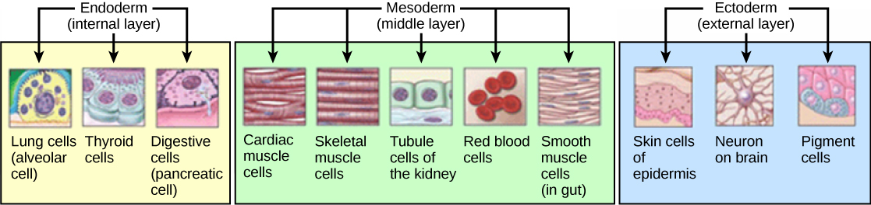
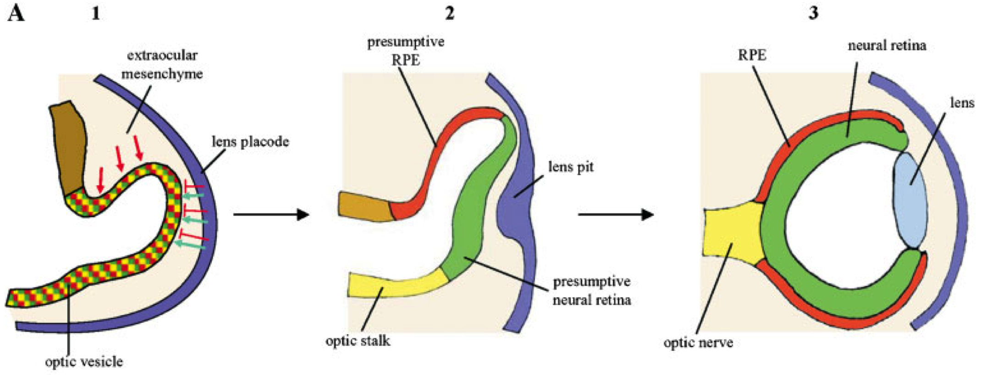
RPE are derived from the same germ layer as skin cells and neuronal cells.
Fuhrmann et al. (2013) Retinal pigment epithelium development, plasticity, and tissue homeostasis. Exp Eye Res.
Martinez-Morales et al. (2004) Eye development: a view from the retina pigmented epithelium. BioEssays.
Notes:
Looking at the predicted age, I think the choice of my tissue is the main factor that affects the clock’s predictive ability. This is further substantiated when I examine the tissues that are used to train Horvath’s clock that my tissue is not among them. However, it is interesting that despite the systematic underestimation, the correlation between the predicted age and the chronological age is very significant. I hypothesise that there may be some tissue specific markers that are shared between my tissue and the tissues that are used to train Horvath’s clock, so I look a little bit more into that.
I found out that retinal pigment epithelium develops from the same germ line as other tissues that are used in Horvath’s clock such as skin tissues and neuronal tissues. In this diagram below, it describes the development of RPE from an optic vesicle into a more differentiated RPE layer. The authors suggest that this layer was derived from an ancestral ectodermal cell containing light-sensitive pigments into the anterior neuroectoderm that eventually derives into the optic neuroepithelium and then the RPE. Similarly, this neuroectoderm has also been described as the progenitor of neural tissues such as neurons and glia (Hartenstein 2015). Because of this shared lineage, I suspect that these tissues share some similar tissue-specific markers initially, but are eventually lost due to differentiation into the highly specialised tissue in RPE.

Slide 21
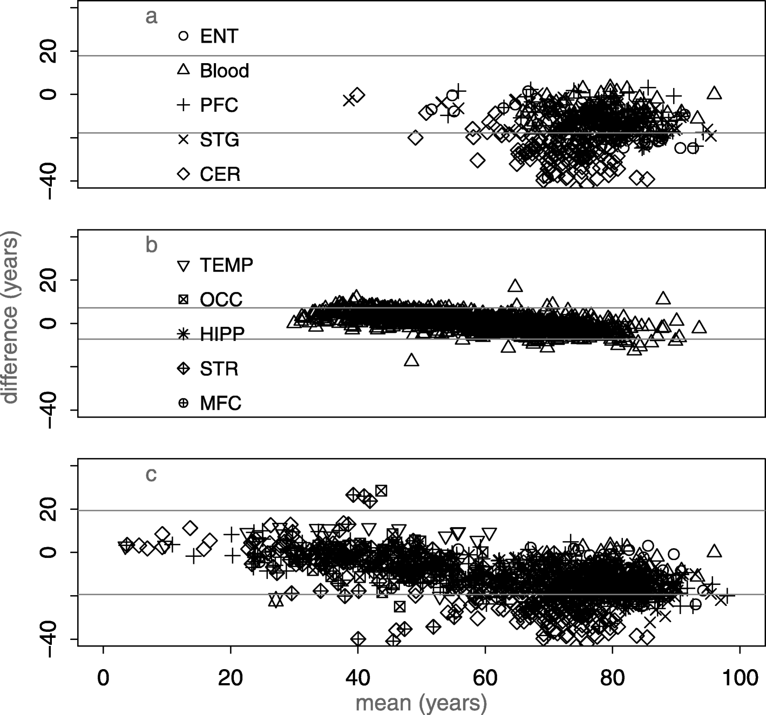
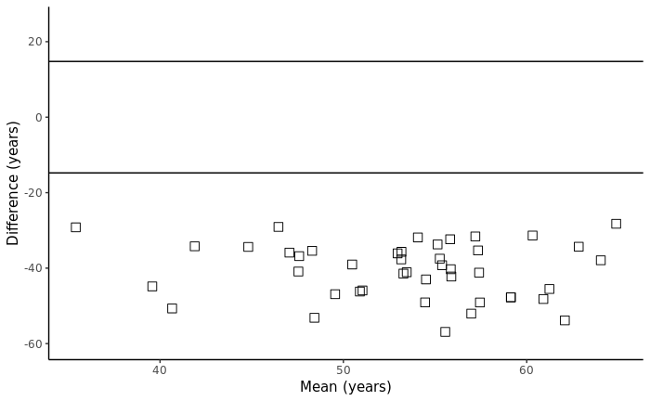
Similar underestimations in biological age are observed in other tissues, estimated using Horvath’s clock.
5 types of brain tissues
Only blood
10 types of brain tissues
My data – Retinal pigment epithelium
El Khoury et al. (2019) Systematic underestimation of the epigenetic clock and age acceleration in older subjects. Genome Biology.
Notes:
Given the shared lineage between my tissue and the ectoderm-derived tissues, I started to look in literature to see if there are other similar tissues that are systematically underestimated as well. Incidentally, the group that built the Cortical clock saw similar underestimations in their datasets of brain tissues, specifically amongst those of older ages. They saw that the clock started to underestimate the brain tissues over 60 years old as seen in this Bland-Altman plot. The expectation from a Bland-Altman plot is that when the means of the predicted age and actual age are plotted against the differences between them, we will see a strong pattern close to 0 if the predictions are accurate. Any deviations from 0 show inaccurate predictions. I plotted a similar Bland-Altman plot to see the predictive performance of my tissue as well and saw similar deviations. The authors propose several ideas that could possibly address this pattern that they are seeing, but the one that is the most relevant to my tissue is the possibility of non-linear aging later in life. They propose that as we age to later in life, the age-associated CpG sites that are characterised by the clocks slowly reach full methylation or complete demethylation, and thus do not represent the methylation patterns captured by the clocks.
The Bland-Altman plot for blood is equally interesting as we see all the points concentrated around 0. This brings up an interesting idea of looking at tissue-specific aging rates, as we see here that the aging of blood is more consistent throughout the different ages.
Only if asked: Explanation of Bland-Altman plot - The Y-axis of a Bland-Altman plot shows the difference between two quantitative measurements (A-B) and the X-axis shows the mean of the two quantitative measurements ((A+B)/2). In other words, the difference between the measurements is plotted against the mean of the measurements. B&A recommends that 95% of all the points should lie within +/- 2 standard deviation of the mean difference. (Giavarina 2015).
Giavarina, Davide (2015) Understanding Bland Altman Analysis. Biochem Med (Zagreb).
Horvath also identified some tissues in his paper where DNAm age are poorly calibrated - breast tissue, uterine endometrium, dermal fibroblast, skeletal muscle tissue and heart tissue; cites underlying biology to explain poor calibration such as hormonal effects in breast tissues, menstrual cycle and concomitant increase in cell proliferation in uterine endometrium etc.

Slide 22
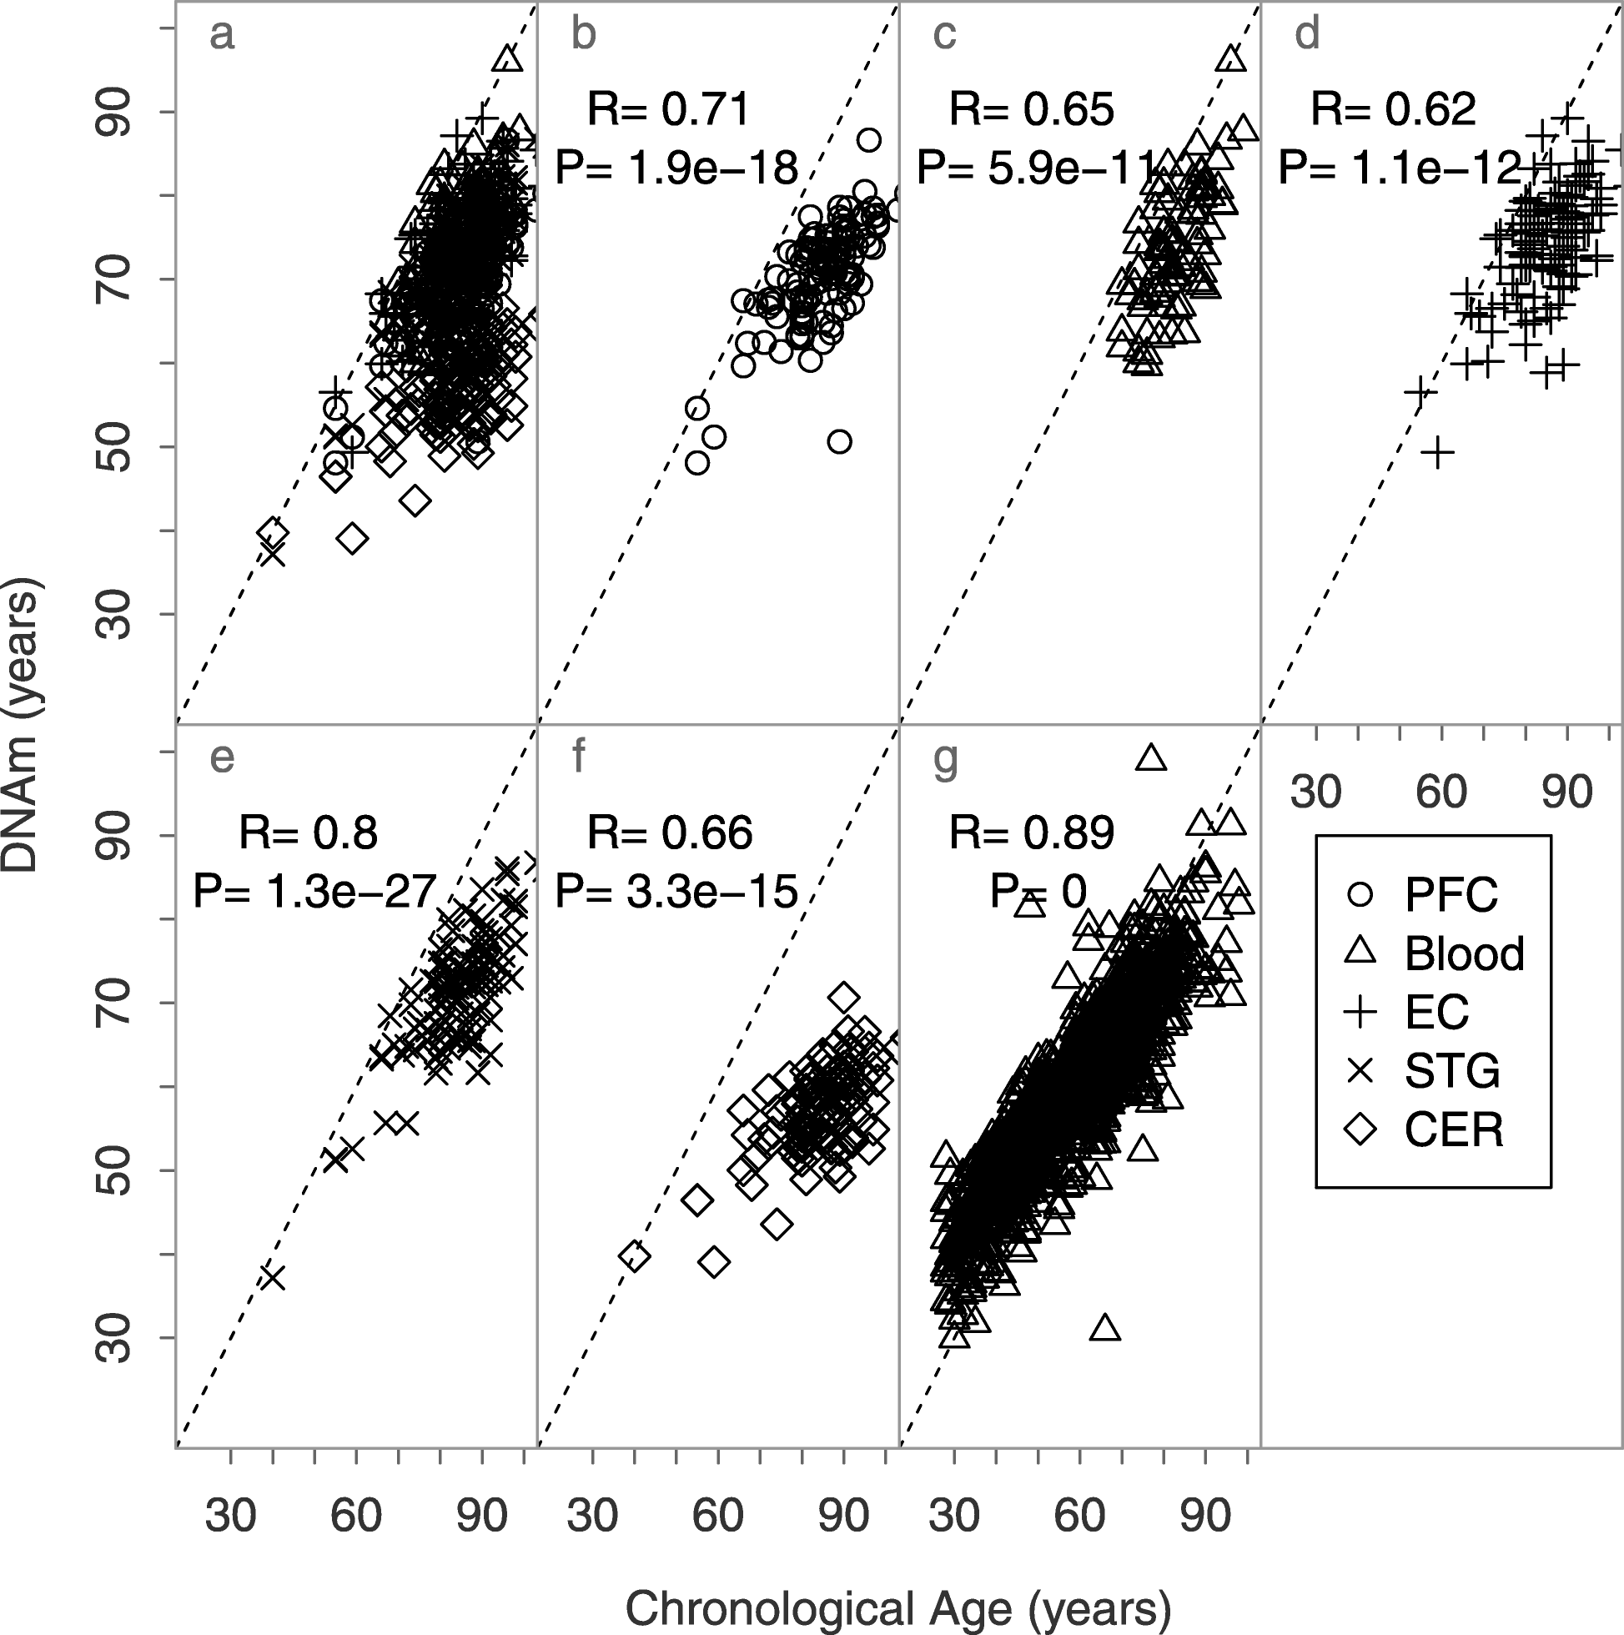
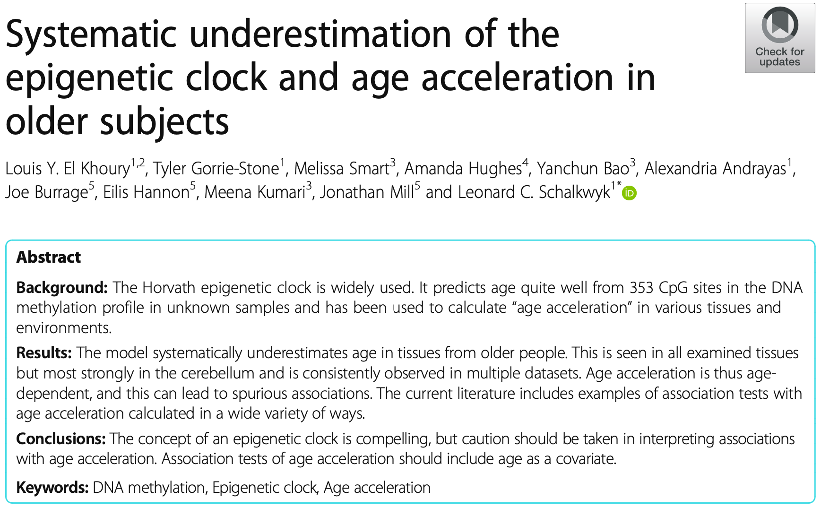
Similar underestimations in epigenetic age are observed in other tissues.
In red outline: Epigenetic age of samples from a previously published EWAS study in Alzheimer’s disease consisting of 5 different tissues.
Not outlined (g): Epigenetic age of blood samples from an independent UKHLS cohort that has a larger sample size and age range.
a: All tissues.
b: Prefrontal cortex.
c: Pre-mortem blood.
d: Entorhinal cortex.
e: Superior temporal gyrus.
f: Cerebellum.
Notes:
Although Horvath’s clock contains a respectable range of ages, it does not have a huge representation of tissue from elderly individuals. There is a bias in sample number used to train the clock towards individuals of younger ages than elderly ones, and as such it is unclear if the clock is accurate in older age groups, or those with age-related diseases.

Slide 23
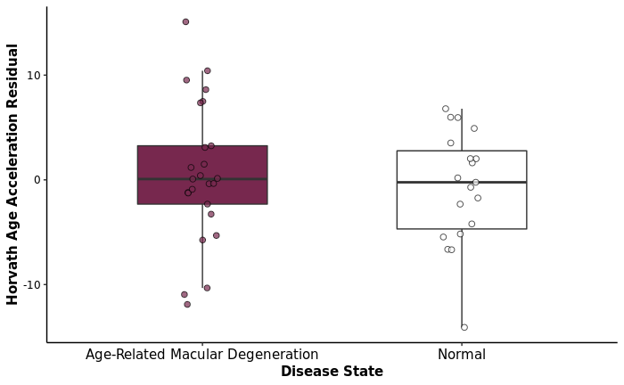
Spread of AMD age acceleration residual is not statistically different from normal age acceleration residual.
F-test p-value > 0.05
Notes:
As the correlation is still significant and high, using age acceleration measures may still be notable, so I investigate the residual plot to see if there are any interesting patterns that are observed between my AMD samples and my controls.
As you can see from my residual plot, the AMD samples show a more spread out residual values as compared to the normal samples, even though the spread is not statistically significant. This may indicate underlying health outcomes or technical artifacts that are driving the age acceleration that are unfortunately not provided in the data.
Only if asked: A host of technical artifacts could explain differences in predictive accuracy: for example, variations in sample processing, DNA extraction, DNA storage effects, batch effects, and chip effects.

Slide 24
Secondary Question:
What are the age-associated CpGs in the retinal pigment epithelium?
Notes:
Picking up on the difference in aging rate in RPE as compared to other tissues in the Bland-Altman plot, I thought it might be interesting to look for any age-associated sites in RPE. Aging in RPE has been explored in other contexts, but not as extensively from an epigenetic perspective.

Slide 25
EWAS
Notes:
To do that, I attempt an EWAS to see if there are any age-associated sites that are attributed to RPE. In the literature, ELOVL2 has been identified as an age-associated site in the retina of mice. I hope to find similar sites in my exploratory study as well.

Slide 26
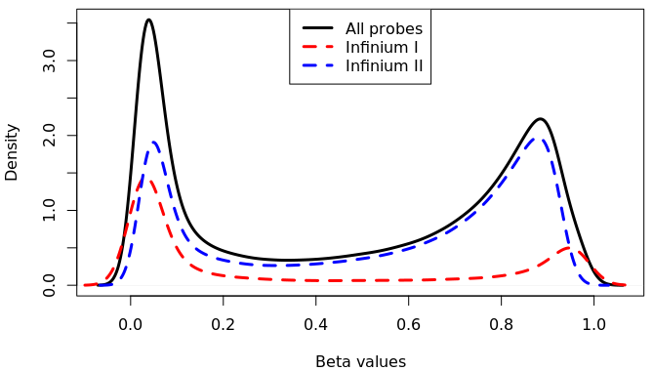
Data Import and Clean-up
44 samples, 485 577 probes
Sample Quality Control
44 samples, 485 577 probes
Raw distribution
Normalisation: Noob
44 samples, 485 577 probes
Normalisation: Funnorm
44 samples, 485 577 probes
Epigenetic Clocks
44 samples, 485 577 probes
Probe Filtering
44 samples, 425 456 probes
SVA
44 samples, 425 456 probes
Funnorm-normalised distribution
Cell Type Deconvolution
44 samples, 425 456 probes
EWAS
44 samples, 425 456 probes
Notes:
Continuing from sample quality control, I performed funnorm on my data. Briefly, I chose funnorm for my EWAS because funnorm is useful for studies comparing conditions with known differences, like a case-control study. Because it is a between-array normalisation method, it will adjust my Type I distribution to be more similar to my Type II distribution, as you can see here.
Only if asked: Funnorm is a between-sample (functional) normalization method that attempts to remove unwanted variation by adjusting for covariates estimated from a control probe matrix. Briefly, 42 summary measures are estimated from the combined 848 control probes and type I ‘out-of-band’ intensities, with the first m = 2 principle components of the summarized measures chosen as covariates for intensity adjustment. Adjustment is performed separately in methylated and unmethylated intensities, and in type I and II probes. For probes mapped to X and Y chromosomes, males and females are processed separately, with ordinary quantile normalization used for probes on the Y chromosome because of the small number of probes (N = 416). By default the functional normalization is applied after Noob in the current version of minfi package.

Slide 27
Data Import and Clean-up
44 samples, 485 577 probes
Initial probe count: 485 577
Sample Quality Control
44 samples, 485 577 probes
After SNP probes filtering: 485 512
After XY probes filtering: 474 929
Normalisation: Noob
44 samples, 485 577 probes
Normalisation: Funnorm
44 samples, 485 577 probes
After cross-hybridizing probes filtering: 434 216
Epigenetic Clocks
44 samples, 485 577 probes
Probe Filtering
44 samples, 425 456 probes
After polymorphic probes filtering: 427 786
SVA
44 samples, 425 456 probes
After detection p-value and bead count filtering: 425 456
Cell Type Deconvolution
44 samples, 425 456 probes
EWAS
44 samples, 425 456 probes
Final probe count: 425 456
Removed probes: 60,121
Notes:
Then I proceeded with our standard probe filtering methods, where XY, SNP, polymorphic, cross reactive and probes that did not pass detection p-value and bead count are removed.
Only if asked:
Polymorphic probes: Probes that target sites that overlap with known SNPs.
Cross-reactive probes: Probes to hybridise to multiple sequences in the genome that are highly homologous, which can generate spurious signals.
Detection p-value: Is a cut-off used to distinguish signal from noise.

Slide 28
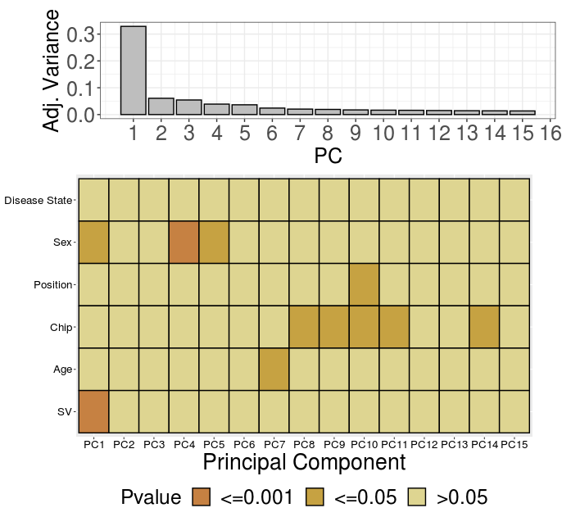
SV in the top PC.
Data Import and Clean-up
44 samples, 485 577 probes
Sample Quality Control
44 samples, 485 577 probes
Normalisation: Noob
44 samples, 485 577 probes
Normalisation: Funnorm
44 samples, 485 577 probes
Epigenetic Clocks
44 samples, 485 577 probes
Probe Filtering
44 samples, 425 456 probes
SVA
44 samples, 425 456 probes
Cell Type Deconvolution
44 samples, 425 456 probes
EWAS
44 samples, 425 456 probes
Notes:
Given that I only have a limited number of biological variables provided, which are age, disease state and sex, I want to see if there are other unmeasured sources of biological variability in my data.
For that, I performed an SVA to look for these unmeasured sources of variation. I do not need to look for technical variations in my data because the batch effects are known. A large issue with this study is the batch and biological variables confounding as I mentioned earlier, so I can either adjust for batch using ComBat and potentially remove any biologically meaningful variations that confound with batch or keep the batch effect as it is, and increase my false positives - neither option is desirable, so I simply opt out of performing ComBat altogether, which is an option chosen by the original authors as well in their study. However, this means that any results that I have from my EWAS need to be interpreted with caution.
The SVA algorithm identified one significant SV, which was added to my PC to see where it shows up, and it showed up as the first PC.
Only if asked: SVA is a supervised method used to identify potentially large number of environmental and biological variations (and technical variations like batch) that are unmeasured and may have a large impact on measurement. It identifies and estimates the unmeasured variation as a surrogate variable while protecting the variables of interest.

Slide 29
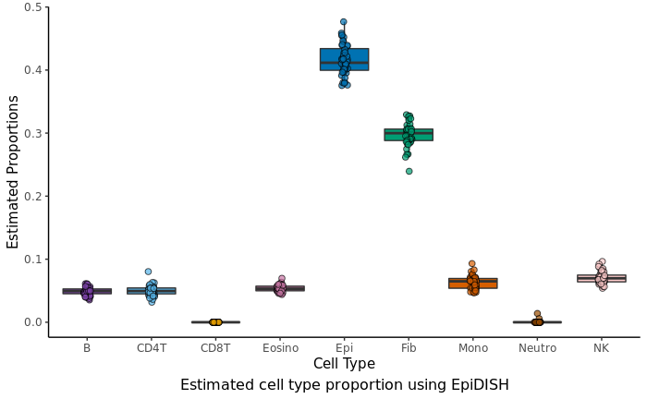
EpiDISH identified higher proportion of epithelial cells and fibroblast, which was expected.
Data Import and Clean-up
44 samples, 485 577 probes
Sample Quality Control
44 samples, 485 577 probes
Normalisation: Noob
44 samples, 485 577 probes
Normalisation: Funnorm
44 samples, 485 577 probes
Epigenetic Clocks
44 samples, 485 577 probes
Probe Filtering
44 samples, 425 456 probes
SVA
44 samples, 425 456 probes
Cell Type Deconvolution
44 samples, 425 456 probes
EWAS
44 samples, 425 456 probes
Notes:
Now that I know my SV is contributing to a large source of variation, I need to identify what it is. I suspect that it may be attributed to the underlying cell type composition or even genetic differences, but unfortunately there is currently no available method to predict cell type for RPE tissues and the authors did not report the ethnicity of the individuals from whom the tissues were derived from. Given the limitation, I decide to go with the next-best option, which is EpiDISH as it is used to infer epithelial cell type differences, and because my tissue is a type of highly differentiated epithelial tissue, I hope that it is able to identify any cell type differences in my tissue. Using the EpiDISH algorithm, I saw that it predicted a high proportion of epithelial cells and fibroblasts, while the blood cells remain low, which is good.
Only if asked: EpiDISH infers the underlying cell type proportions using robust partial correlations of the CpGs that are mapped to the reference database that was identified using a supervised selection procedure that looks for DHS (DNase Hypersensitive sites) and differentially methylated CpGs for each cell type.
DHS sites are lymphocyte specific, indicating that these sites can be used to identify gene regulatory elements that control cell type specificity.
What are fibroblasts? Fibroblasts are the most common connective tissue that synthesise the extracellular matrix and produce collagen.

Slide 30
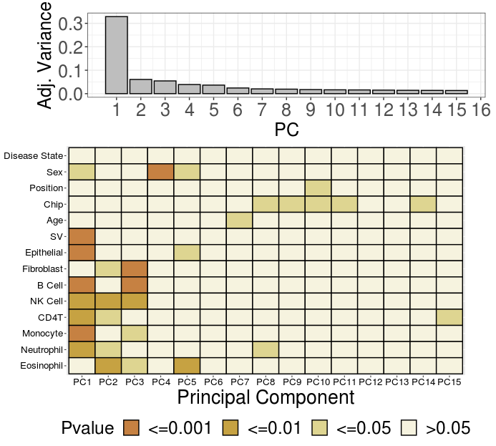
SV correlated with cell type.
Data Import and Clean-up
44 samples, 485 577 probes
Sample Quality Control
44 samples, 485 577 probes
Normalisation: Noob
44 samples, 485 577 probes
Normalisation: Funnorm
44 samples, 485 577 probes
Epigenetic Clocks
44 samples, 485 577 probes
Probe Filtering
44 samples, 425 456 probes
SVA
44 samples, 425 456 probes
Cell Type Deconvolution
44 samples, 425 456 probes
EWAS
44 samples, 425 456 probes
Notes:
I see that predicted cell types show up as the top PC with the SV, so I suspect that they may be correlated.

Slide 31
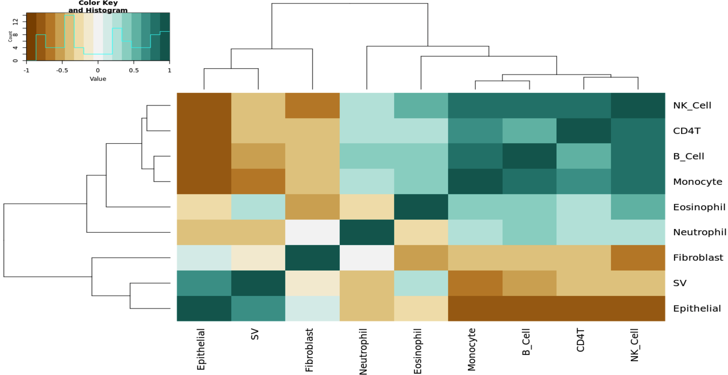
SV is correlated with cell type, specifically epithelial cell predicted using EpiDISH.
Notes:
So, using a correlation matrix, I see that my SV and specifically, the epithelial cell are correlated. This allows me to infer that my SV can be interpreted as a potential surrogate for intraindividual epithelial cell proportion differences in my data.

Slide 32
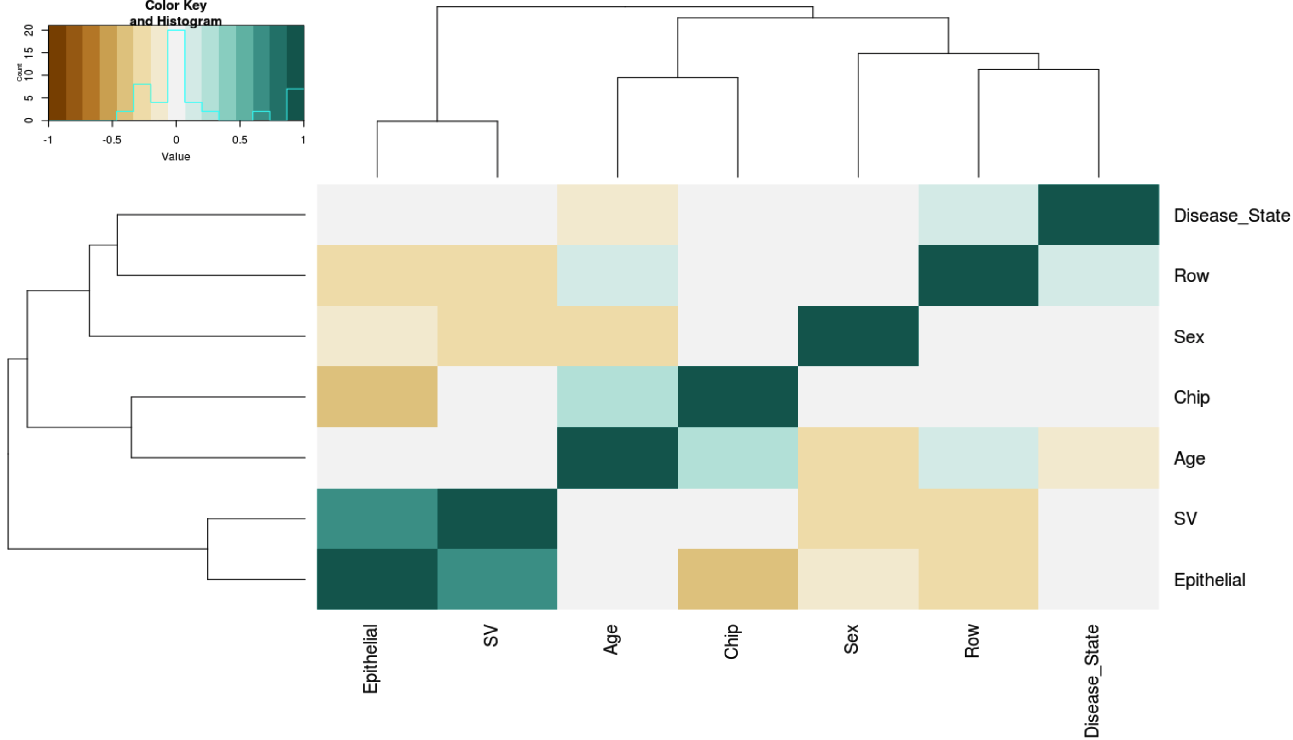
Correlation between all variables
Notes:
After that, I look at the overall correlation between all my variables, and I still see the correlation between age and chip and disease state and row in my dataset.

Slide 33
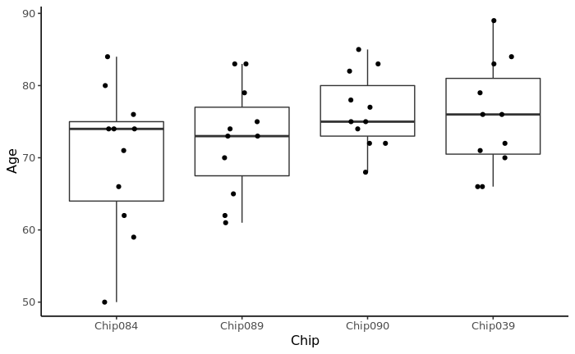
Limitations in design
Batch effect confounding with main variable, i.e. Age is confounded by Chip.
Question of power in detecting significant aging sites.
Notes:
Because I’m interested in age as my main variable, I plot the ages across all chips and see that the ages are not evenly distributed across all chips.

Slide 34
Differences in pipelines
Sample Quality Control
44 samples, 485 577 probes
Sample Quality Control
44 samples, 485 577 probes
Detection p-value, bead count, M+U median intensity, control metrics, sample relations, contamination check, outlier detection, sex check.
Kobor Lab pipeline
Detection p-value, M+U median intensity, control metrics, sex check.
Normalisation: Funnorm
44 samples, 485 577 probes
Normalisation: SWAN
44 samples, 485 577 probes
Probe Filtering
44 samples, 425 456 probes
Probe Filtering
44 samples, 437 486 probes
Sex probes, cross-hybridising, SNP and polymorphic, high detection p-value probes removal.
Sex probes, cross-hybridising, SNP and polymorphic, high detection p-value probes removal.
Surrogate Variable Analysis
44 samples, 425 456 probes
EWAS
44 samples, 437 486 probes
Cell Type Deconvolution
44 samples, 425 456 probes
EWAS
44 samples, 425 456 probes
Porter et al.’s pipeline
Notes:
This makes me think back about the preprocessing steps that the authors undertook, and reinforced the idea that the authors chose to skip ComBat for the reasons described previously.

Slide 35
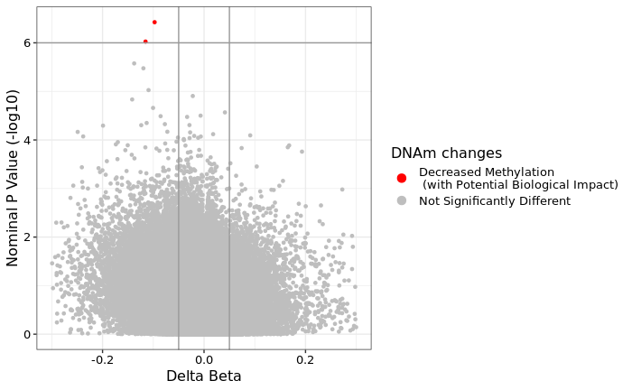
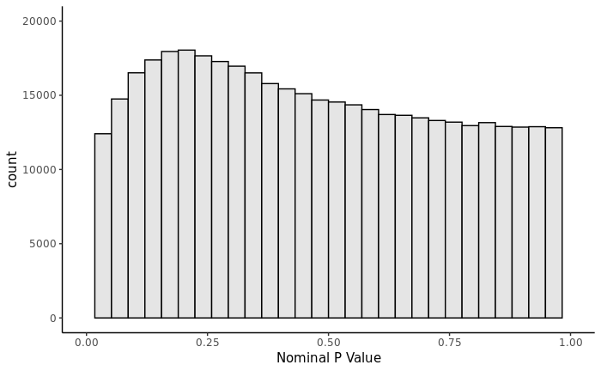
Using Porter et al.’s model with my pipeline fails to reproduce the differential methylation hits associated with age-related macular degeneration.
cg07685601
UCSC RefSeq: MAD1L1
FDR < 0.2
cg08744475
FDR > 0.2
DNAm ~ Disease State + Sex + (Disease State $×$Sex) + Chip
CpG | p-value | FDR-adj. p-val | Delta beta | Chromosome | RefGene Name | RefGene Group
cg07685601 | 3.7x10⁻⁷ | 0.160 | -0.097 | 7 | MAD1L1 | Body
cg08744475 | 9.4x10⁻⁷ | 0.200 | -0.115 | 6
Notes:
This is my attempt to replicate Porter et al.’s EWAS hits but failed to get the same results as they did.

Slide 36
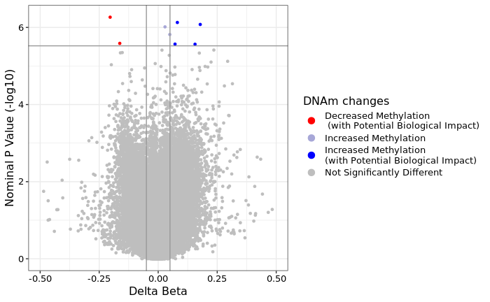
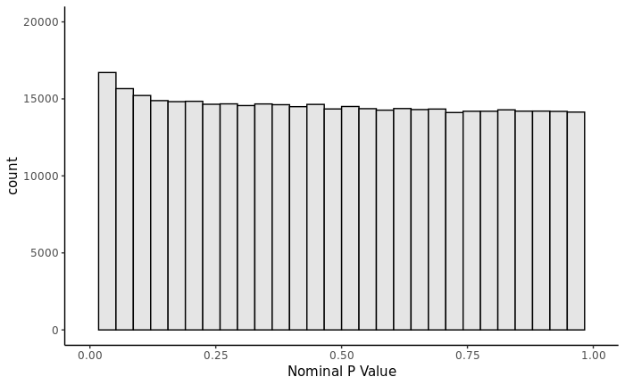
Six age-associated CpG sites are identified with FDR-adjusted p-value < 0.2.
DNAm ~ Age + Sex + SV + Chip
Notes:
After understanding the potential batch effect as a confounder in my dataset, I performed an EWAS using the linear model [shown on my slide], explicitly accounting for my cell-type differences through my SV, sex and the chip effect (which is confounded with age). I did not adjust for disease state because if you recall from my raw data PCA, the disease is not a large source of variation in my data and I don’t want to overburden my model, especially in such a small sample size. I identified four increased methylated CpG sites and two decreased methylated CpG sites that are associated with age with delta beta more than 5%.

Slide 37
LOC100132215 previously associated with aging, ANK1 implicated in Alzheimer’s disease and FOXB1 is described as a regulator for embryonic neuroepithelium development.
CpG | p-value | FDR-adj. p-val | Delta beta | Chromosome | RefGene Name | RefGene Group
cg15155209 | 5.4x10⁻⁷ | 0.102 | -0.203 | 3 | SLC6A6 | Body
cg21132564 | 7.4x10⁻⁷ | 0.102 | 0.081 | 8 | ANK1 | Body
cg06968164 | 2.5x10⁻⁶ | 0.144 | -0.162 | 13
cg22197050 | 2.7x10⁻⁶ | 0.144 | 0.071 | 2 | LOC100132215 | TSS1500
cg19005438 | 2.7x10⁻⁶ | 0.144 | 0.156 | 15 | FOXB1 | TSS1500
cg06173889 | 3.8x10⁻⁶ | 0.151 | 0.235 | 2 | SOX11 | 3’UTR
Notes:
While I can’t stress enough that these 6 sites should be interpreted with caution because of the limitation of the study design and the question of power due to its sample size, I am intrigued to look at what these sites are just out of sheer curiosity. Out of the 6, I found these three sites to be particularly interesting for various reasons.

Slide 38
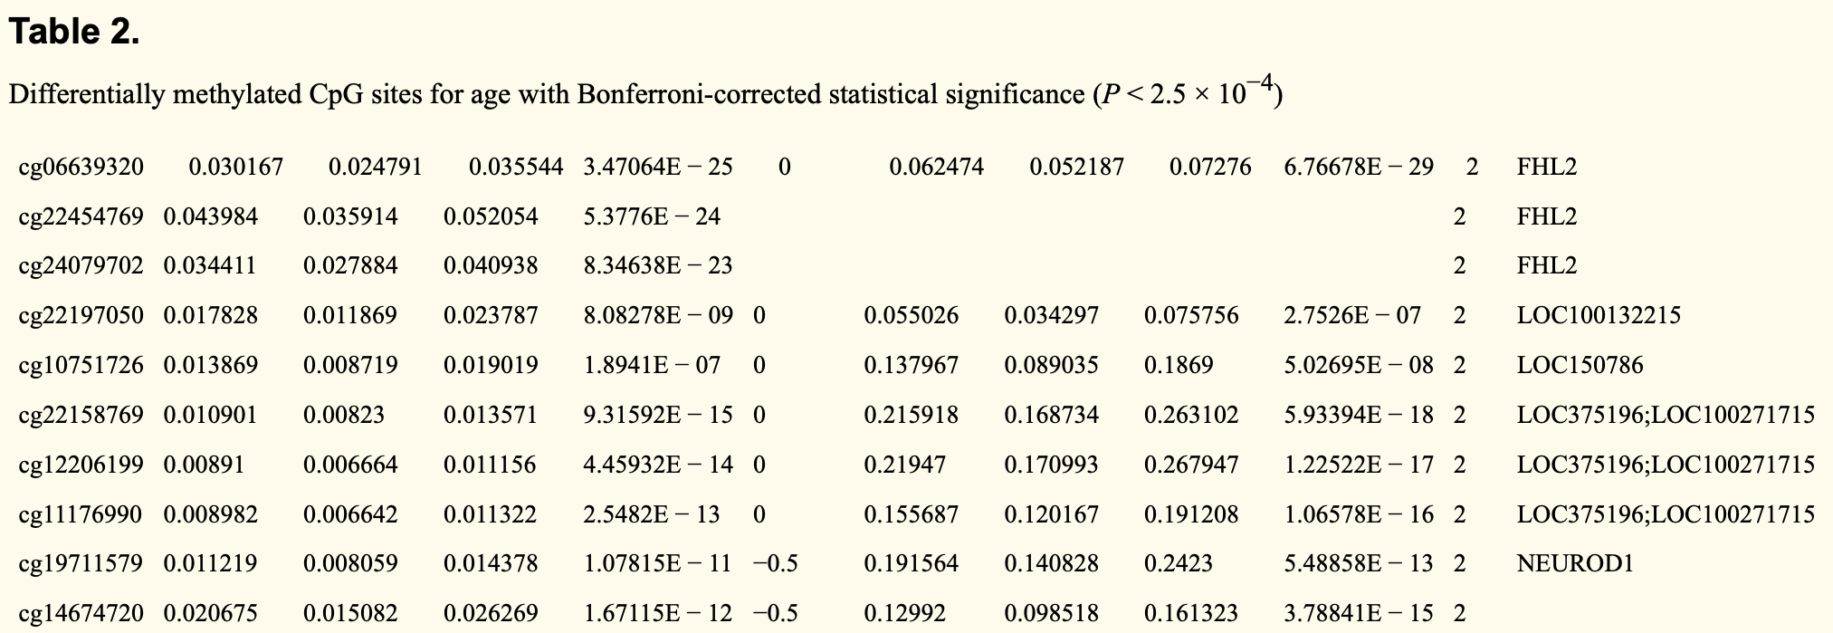
LOC100132215 was previously identified as one of the 162 age-associated CpGs in a 400-individual cohort aged between 50 – 75 years old.
Florath et al. (2014) Cross-sectional and longitudinal changes in DNA methylation with age: an epigenome-wide analysis revealing over 60 novel age-associated CpG sites. Human Molecular Genetics.
Notes:
Firstly, LOC100132215 was previously identified as age-associated in the whole blood of 400 individuals aged between 50 to 75 years old. This is interesting because the cohort that they use share a similar age range with the individuals in my data, and the fact that they validated these sites in a separate longitudinal study (after 8 years) suggests that this site may be interesting to explore as another potentially non-tissue specific site since it was identified in the whole blood of their much better powered study.

Slide 39

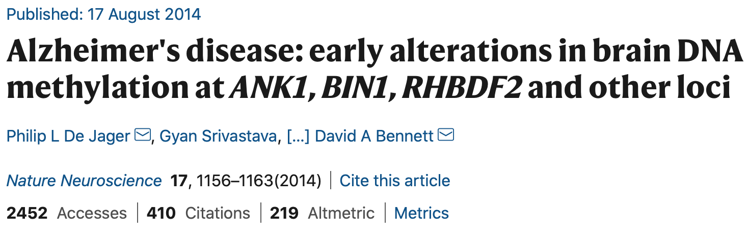
ANK1 is directly involved in the pathogenesis of Alzheimer’s disease.
Notes:
Secondly, ANK1 has been identified as a differentially methylated region in Alzheimer’s disease, which is another age-related disease. ANK1 encodes brain-expressed protein and has been associated with the entorhinal cortex which is a primary site of AD manifestation. Although it is still not known how ANK1 relates with aging, it is still interesting to see that this site is directly involved in pathogenesis of an age-related disease.
(Age is a risk factor in Alzheimer’s disease.)

Slide 40

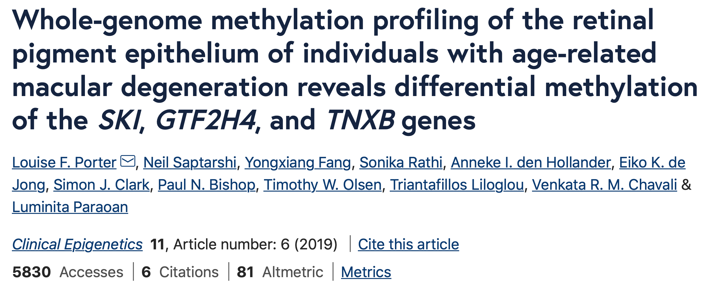
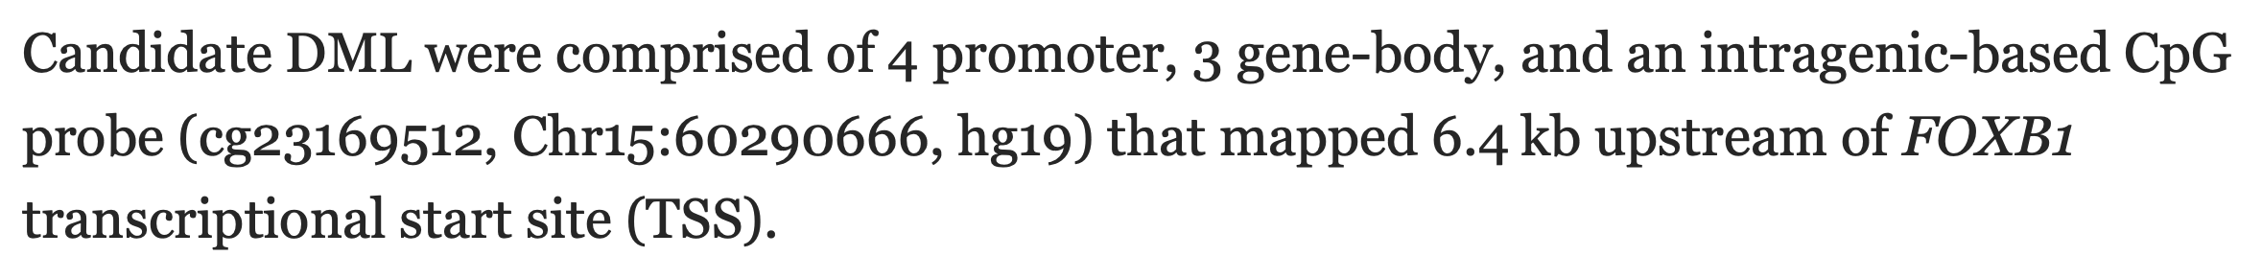
FOXB1 is widely expressed in neuroepithelium – the progenitor state of RPE. Its TSS is also a target for AMD-candidate CpGs.
Notes:
Lastly, I found a paper that showed that FOXB1 is involved in the regulation of neurodevelopmental cascade, and is widely expressed in the neuroepithelium, which is a similar tissue that RPE is derived from. To bring this project full circle, it is seen that the differentially methylated sites that were identified in this dataset to be associated to AMD, regulate the transcription of FOXB1.

Slide 41
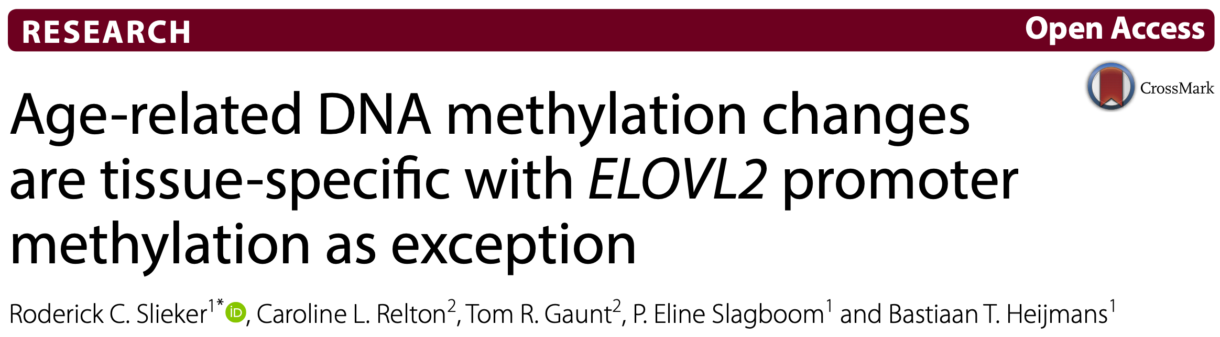
Other non-tissue specific age-associated sites previously identified are not significant in this dataset.
CpG | p-value | FDR-adjusted p-value | Delta beta | Chromosome | UCSC RefGene
cg22454769 | 0.0248804 | 0.7252093 | 0.05827410 | 2 | FHL2
cg06639320 | 0.3367485 | 0.9043558 | 0.02140123 | 2 | FHL2
cg16867657 | 0.0004391873 | 0.5528210 | 0.09583086 | 6 | ELOVL2
cg24724428 | 0.0030391951 | 0.6188314 | 0.10685771 | 6 | ELOVL2
cg21572722 | 0.0265274260 | 0.7303255 | 0.05046642 | 6 | ELOVL2
Notes:
Unfortunately, I am not able to identify the commonly known non-tissue specific age-associated sites such as ELOVL2 and FHL2 in my dataset. I look at these sites from my model and saw that they are ranked in the top 500 sites to be associated with age in this dataset.

Slide 42

Acknowledgements
I’d like to thank the following people for their guidance and advice through this project:
Dr. Michael Kobor
Nicole
David
Bioinformatics Team
Human Working Group
And all the members of Kobor Lab.
Happy Thanksgiving!
Notes:
With that, I would like to thank Mike for your mentorship, Nicole and David - both of whom have dedicated so much time to provide me with advice and guidance that help me tremendously in driving the direction of this project. I would also like to acknowledge the Bioinformatics team and the Human Working Group for allowing me to discuss and troubleshoot the difficulties that I faced in this data, and lastly to all of you for your attention and participation today. Thank you everybody and Happy Thanksgiving!

Slide 43
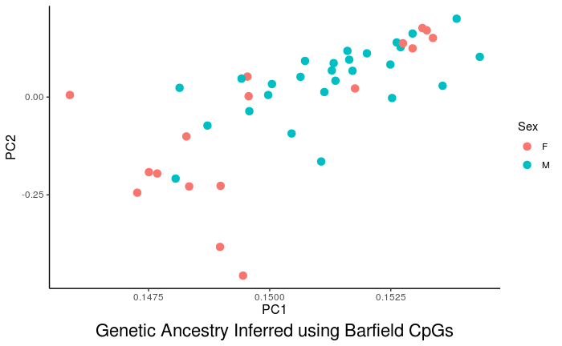
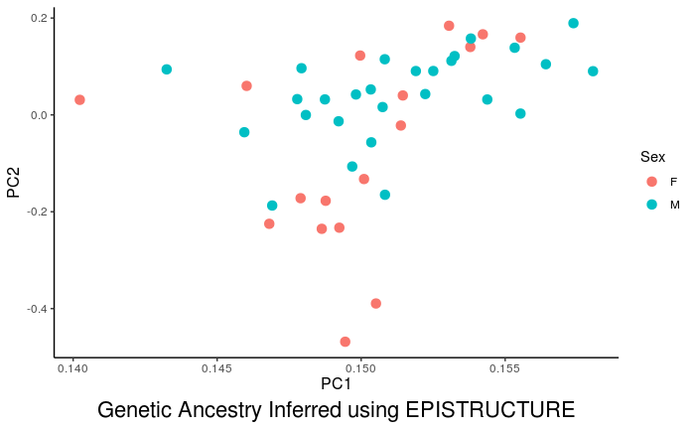
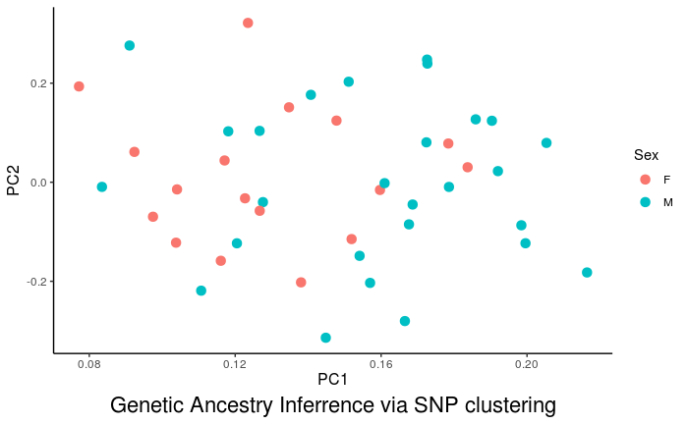
Supplementary
Genetic Ancestry Inference using Barfield and EPISTRUCTURE CpG sites and Zhou’s SNP probes method.

Slide 44
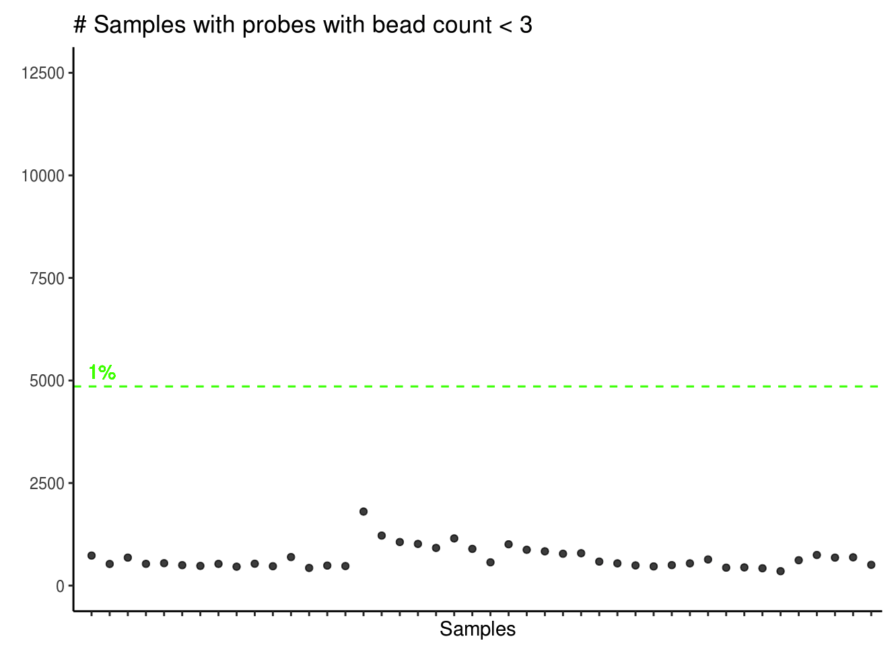
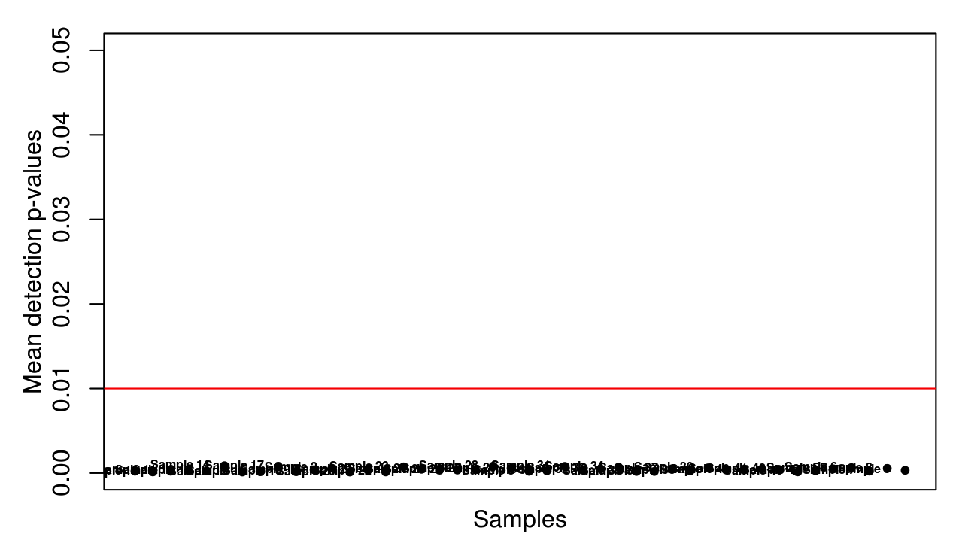
Supplementary
Sample QC – Detection p-value and bead count

Slide 45
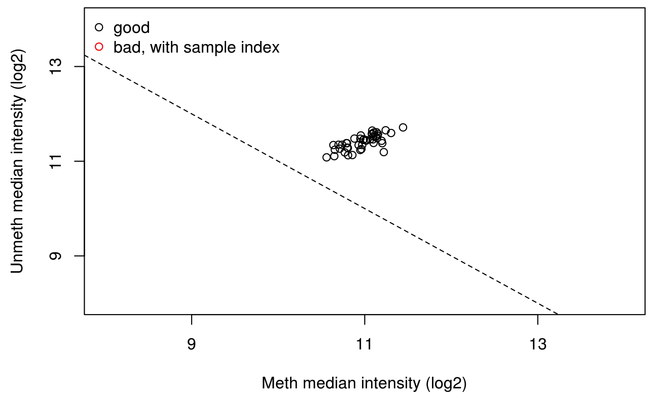
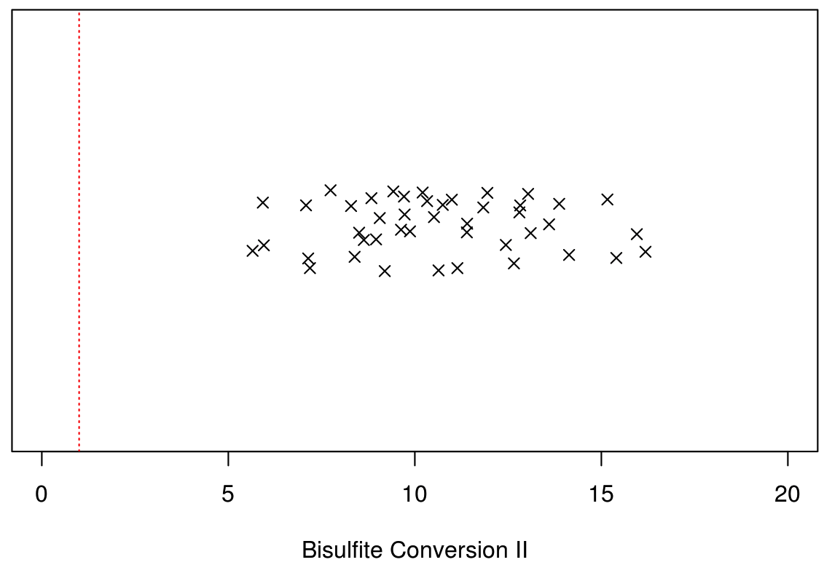
Supplementary
Sample QC – M+U median intensity and control metrics

Slide 46
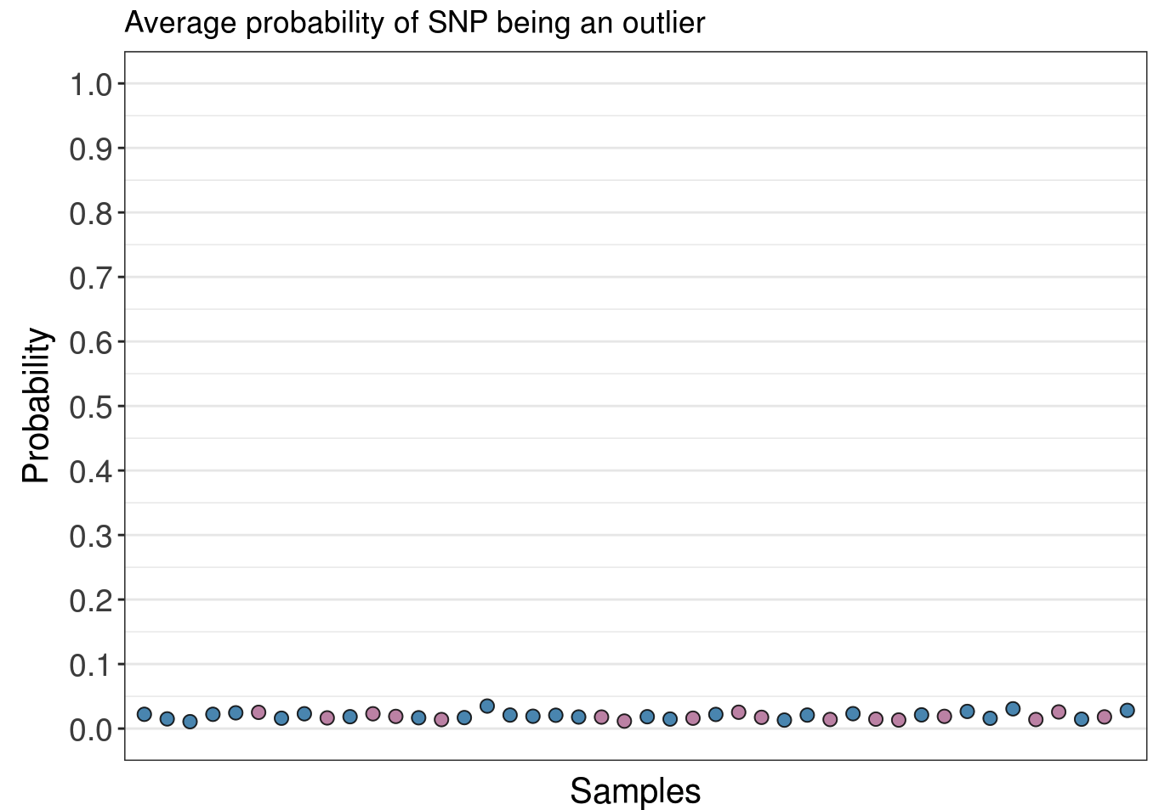
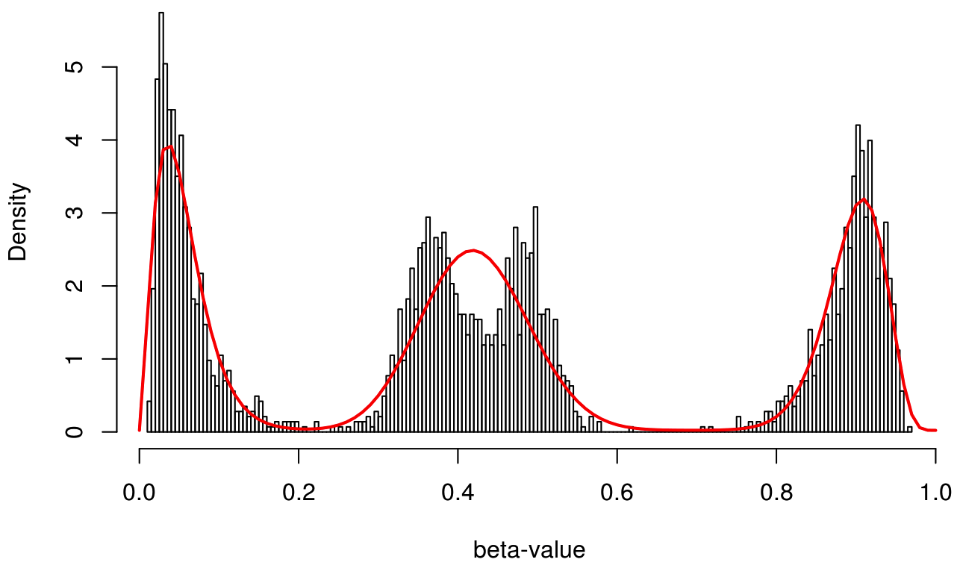
Supplementary
Sample QC – SNP genotype and outlier probability

Slide 47
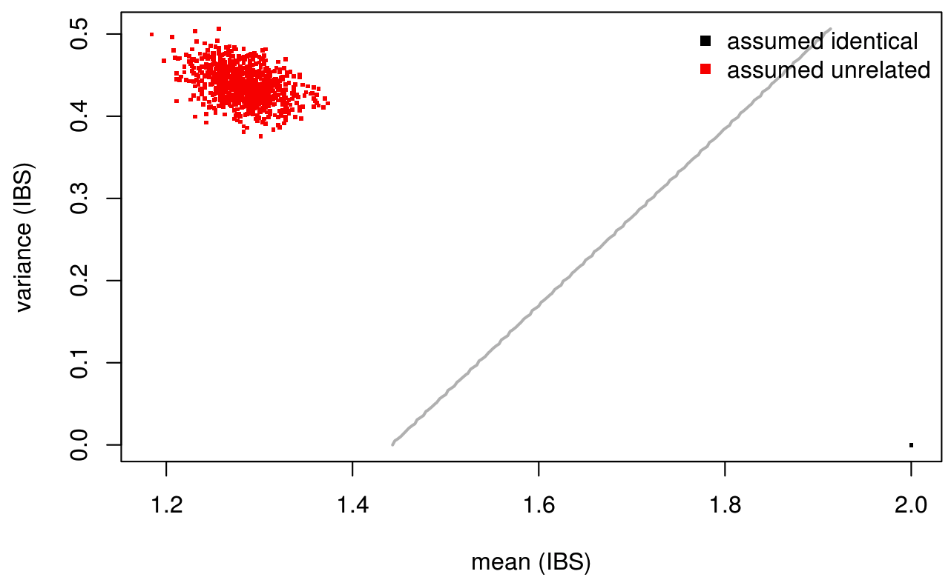
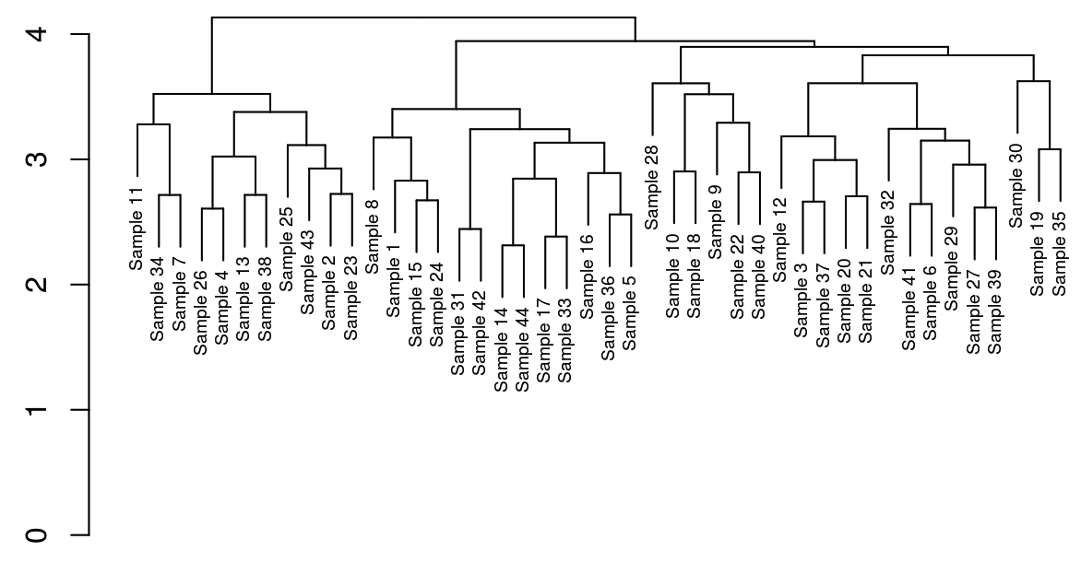
Supplementary
Sample QC – Sample relations and identity

Slide 48
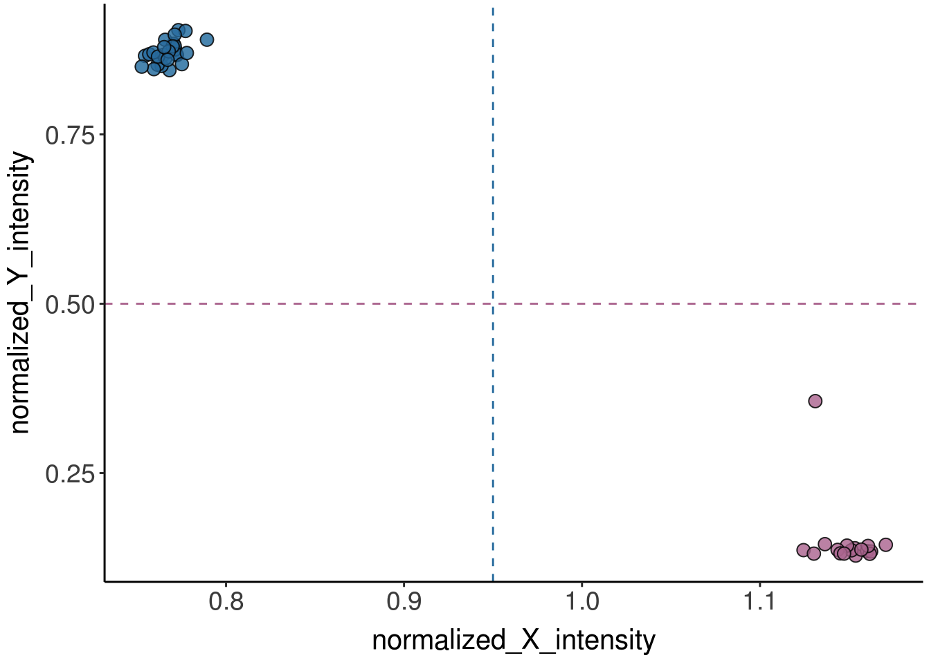
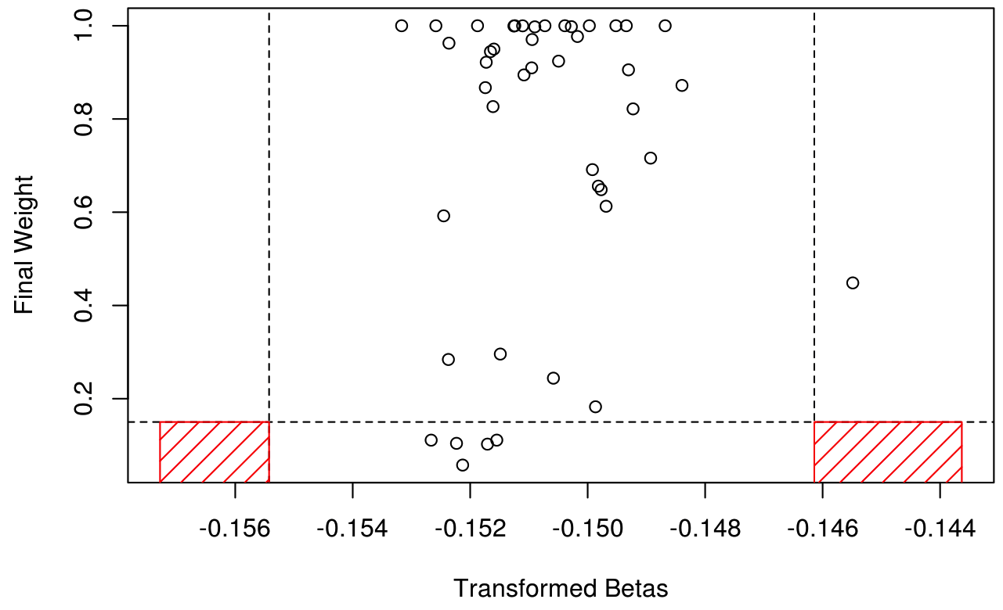
Supplementary
Sample QC – Outlier detection and sex check

Slide 49
Supplementary
Summary of outputs from all epigenetic clocks:
Epigenetic Clock | DNAmAge CpGs | Predicted Age Range | Actual Age Range | R (p-value) | Mean Age Acceleration Residual (Range Age Acceleration Residual)
DNAmHorvath (Horvath 2013) | 353 | 15.32 – 50.76 | 50 – 89 | 0.48 (0.00096) | AMD: 0.569 (-11.896 – 15.096) Normal: -0.748 (-14.089 – 6.792)
DNAmSkin&Blood (Horvath et al. 2018) | 391 | 0.85 – 14.04 | 50 – 89 | 0.41 (0.0057) | AMD: 0.615 (-18.015 – 14.041) Normal: -0.810 (-11.408 – 9.996)
DNAmZhang (Zhang et al. 2019) | 514 | 17.97 – 48.40 | 50 – 89 | 0.39 (0.0081) | AMD: 0.539 (-13.817 – 12.510) Normal: -0.709 (-10.718 – 7.883)
DNAmHannum (Hannum et al. 2013) | 71 | 13.09 – 44.86 | 50 – 89 | 0.36 (0.015) | AMD: 0.577 (-13.613 – 14.777) Normal: -0.760 (-9.696 – 7.662)
DNAmCortical (Shireby et al. 2020) | 347 | -18.56 – (-12.61) | 50 – 89 | 0.35 (0.019) | AMD: 0.157 (-2.442 – 2.641) Normal: -0.206 (-2.584 – 1.609)
DNAmWeidner (Weidner et al. 2014) | 3 | -0.74 – 49.20 | 50 – 89 | 0.28 (0.066) | AMD: 0.448 (-25.350 – 28.632) Normal: -0.590 (-13.239 – 10.676)
DNAmPhenoAge (Levine et al. 2018) | 513 | -51.75 – 8.87 | 50 – 89 | 0.18 (0.23) | AMD: 0.768 (-41.542 – 20.894) Normal: -1.010 (-25.282 – 16.225)

Slide 50
Similar underestimations in epigenetic age are observed in other tissues.
3 possible reason provided for the underestimation in epigenetic age:
On non-linearity of the clock later in life: Due to saturation as we approach later life, where the CpG sites represented in the clock reaching either full methylation (100%) or complete demethylation (0%).
On the choice of tissue: Hydroxymethylation occurs at a higher level in brain tissues – which may be affecting the predicting power of the clock as hydroxymethylation is indistinguishable to methylation after bisulphite conversion and we do not know presently how hydroxymethylated sites are affected by age-associated changes.
On the predictive ability of the clock: The clock is built without an equal representation of samples across the age-range. Predictive ability might be influenced by the bias in the age of sample used to train the clock.
El Khoury et al. (2019) Genome Biology.
Notes:
They determined that there is a non-linearity to the clock later in life as shown in the figure. One way the clock rate could be reduced in later life is due to saturation, i.e. the CpG sites represented in the clock reaching either full methylation or complete demethylation. They identified 3 probes in the Horvath clock (cg12830694, cg24580001 and cg02580606) that might be candidates for saturation because they are highly methylated and expected to be increasing in methylation with age.
So why 60 years old? The authors mention that the mechanisms of the apparent change in gears in a person’s sixties are not clear, but they argue that part of the effect seems to be due to saturation, i.e. loci approaching the limits of 0 or 100% methylation.
They also cite that perhaps, because of the brain tissues used, there could be hydroxymethylation effect that are present at appreciable levels in these tissues that may be affecting the predictive power of Horvath’s clock (due to the currently unknown age-associated changes to hydroxymethylated sites).
When comparing DNAm profiles across tissues, individuals and other variables, the predominant source of variation is the tissue, more specifically, cell type, so it is reason to suppose that this developmental blueprint can change over time in response to the environment, or simply drift or decay.
Any phenotype associated with age will appear to be associated with age acceleration as well, and a correct analysis should include chronological age as a covariate.

